Slide 1
Orientation to the Discussion Forums

Slide 2
CONTENTS:
Why Forums matter
Define and locate a Forum
Define and locate a thread
Reply to a message or post a new message
Display options: “Nested” vs. “Threaded”
Add links
Add images

Slide 3
Why Forums Matter

Slide 4
Locate and Define a Forum

Slide 5
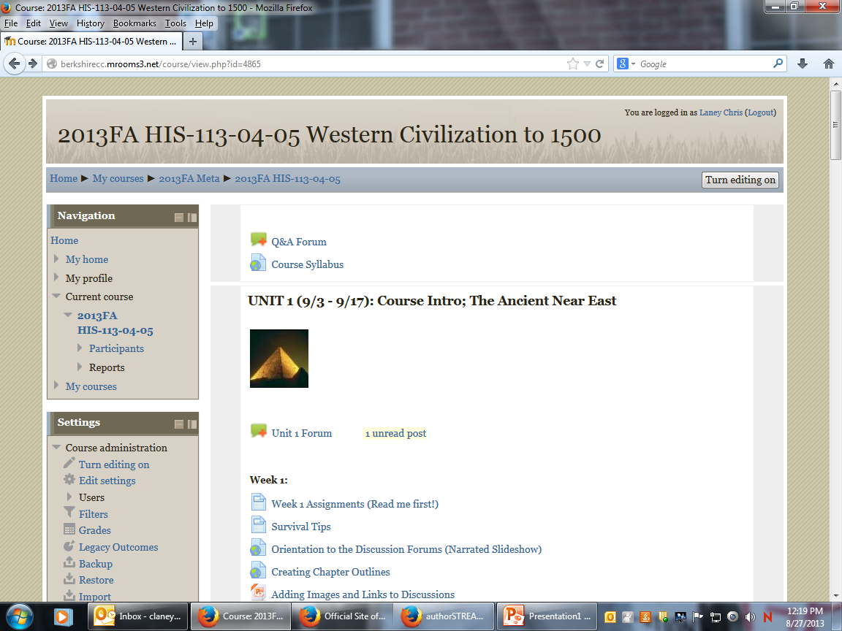
Define and Locate a Forum

Slide 7
Define and locate a thread

Slide 8
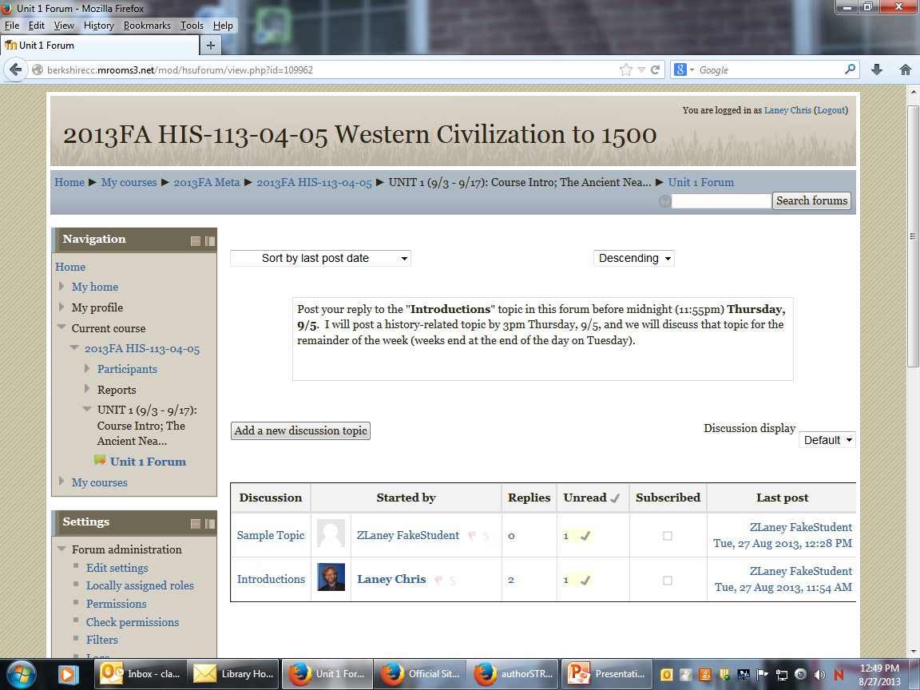

Slide 12
Reply to a message

Slide 13
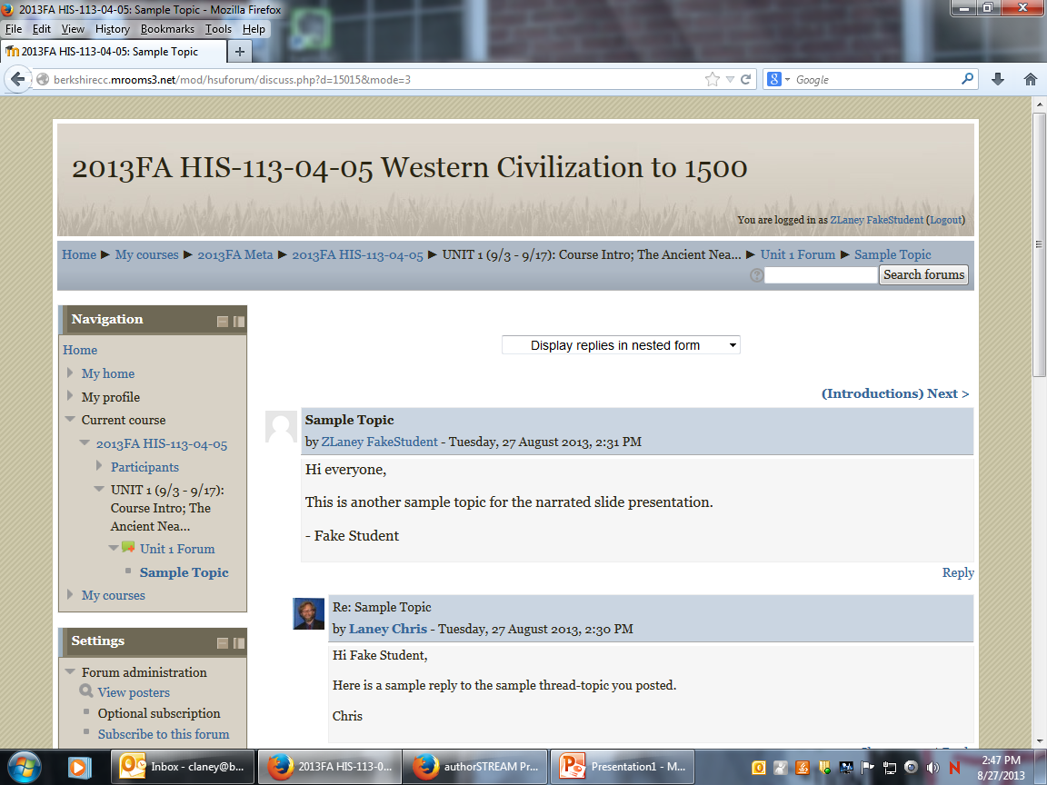

Slide 14
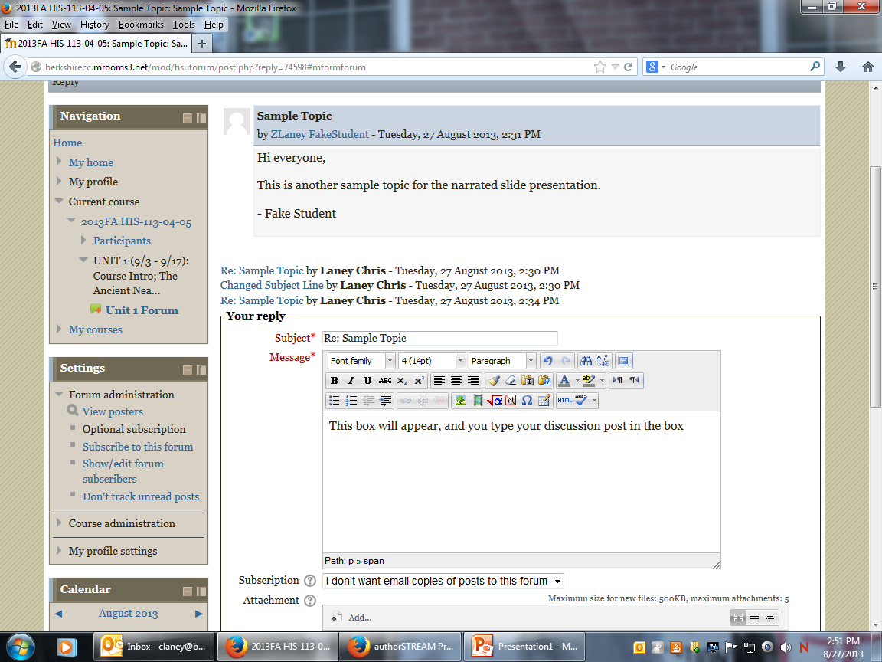

Slide 15
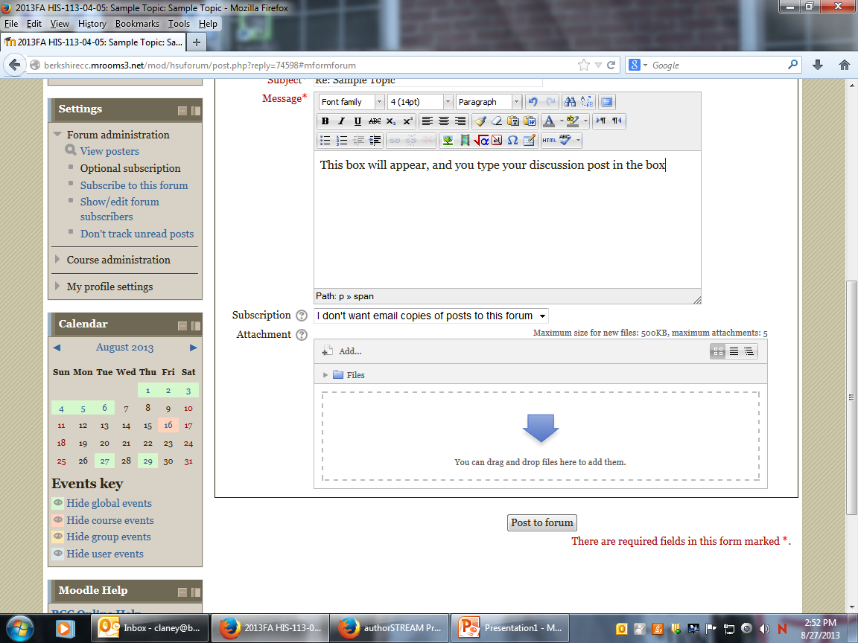

Slide 16
Add a new discussion topic

Slide 17
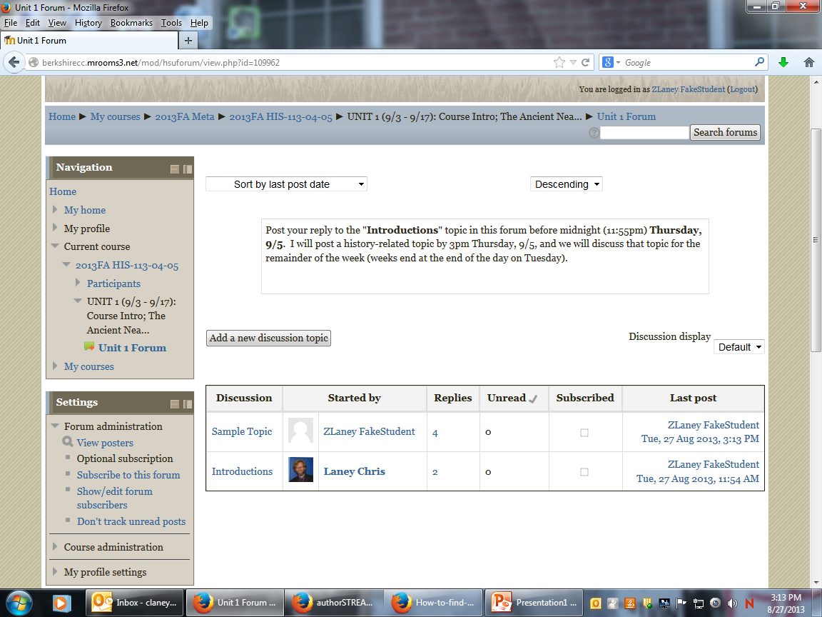

Slide 18
“nested” vs. “threaded” view

Slide 20
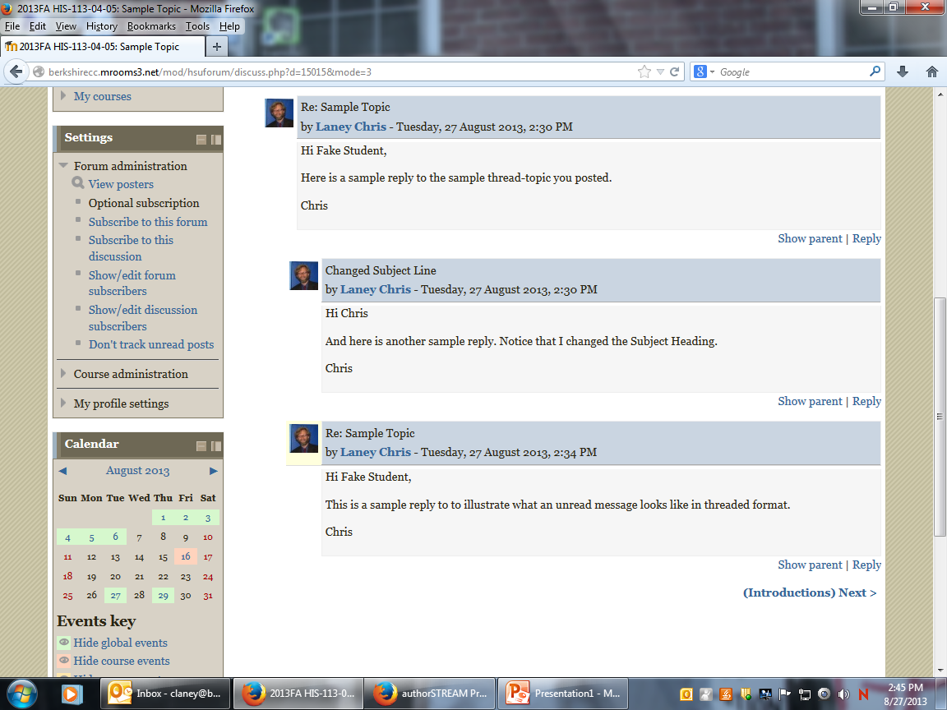

Slide 21
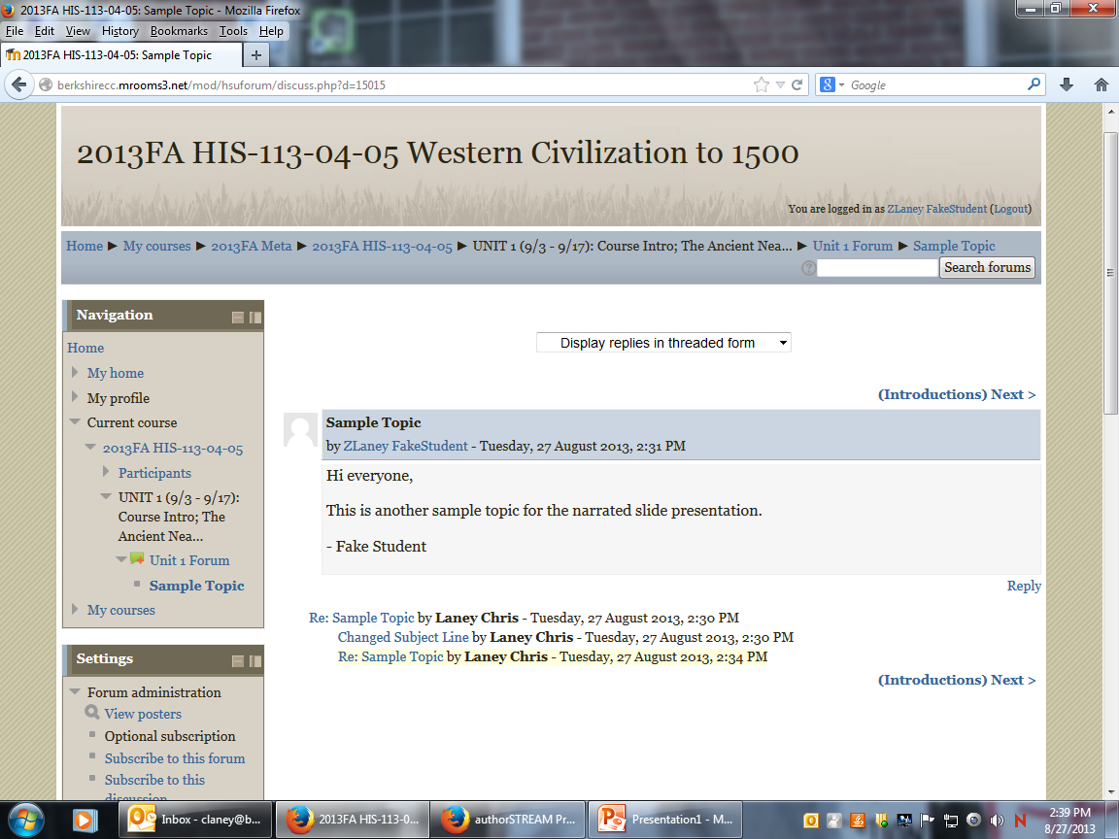

Slide 23
Add links

Slide 24
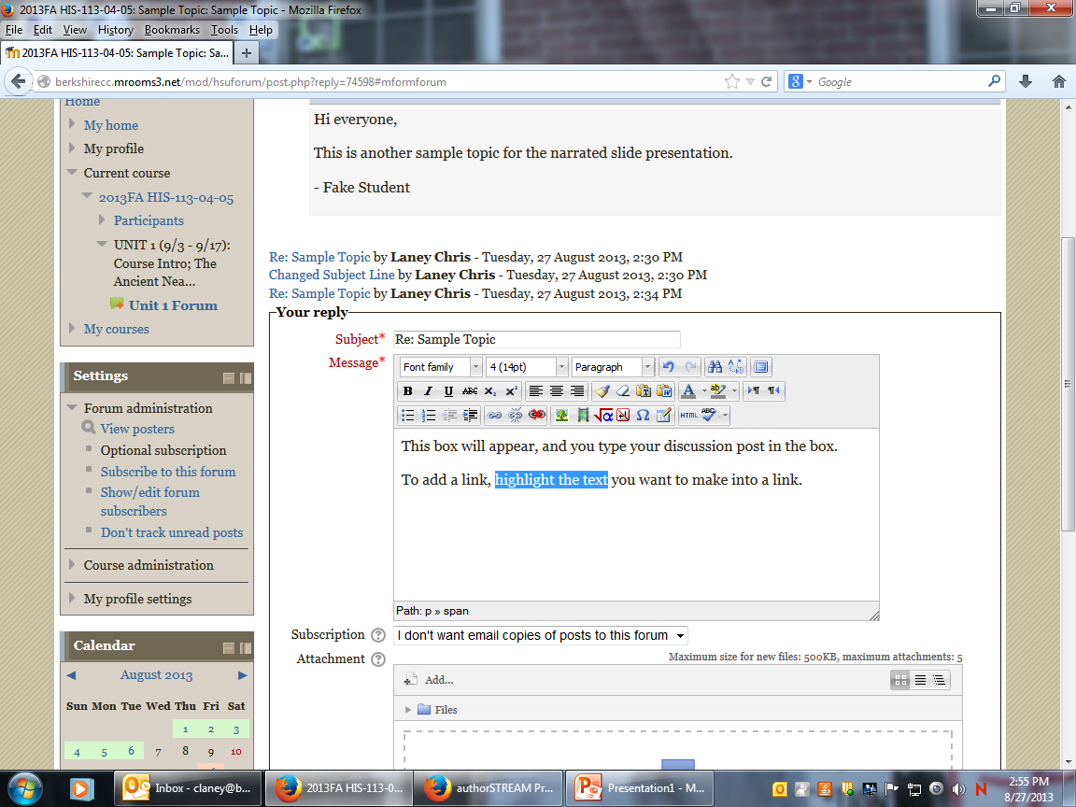

Slide 26
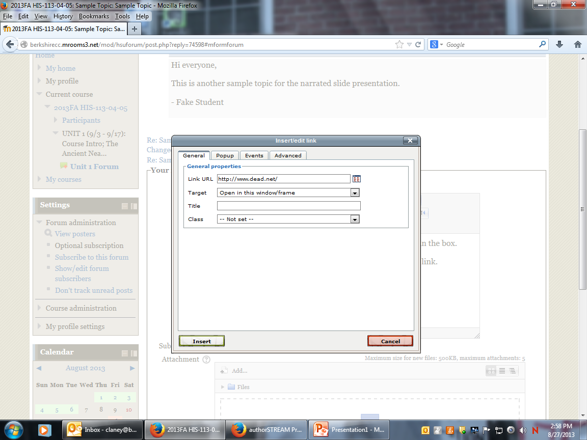

Slide 28
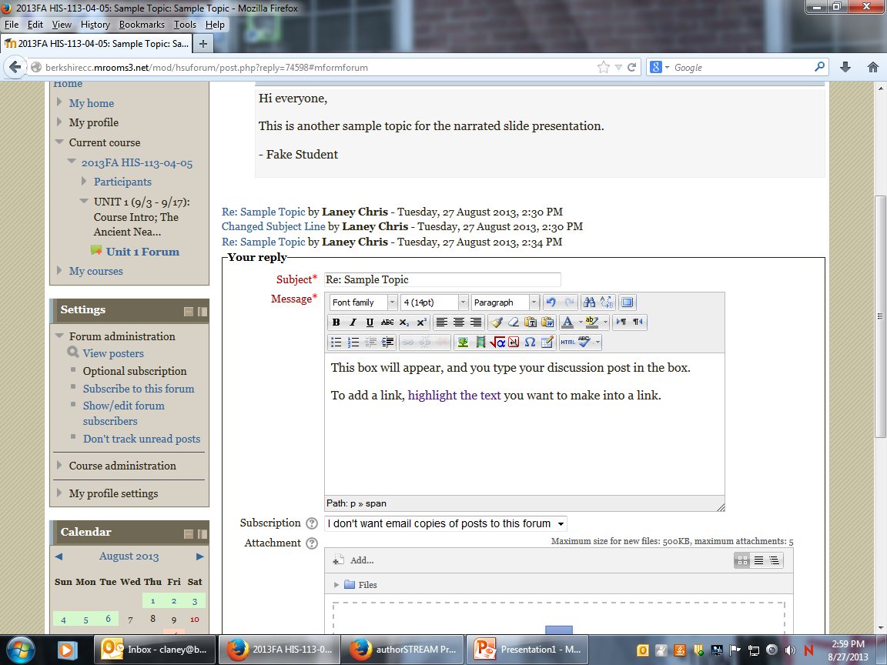

Slide 29
Add Images

Slide 30
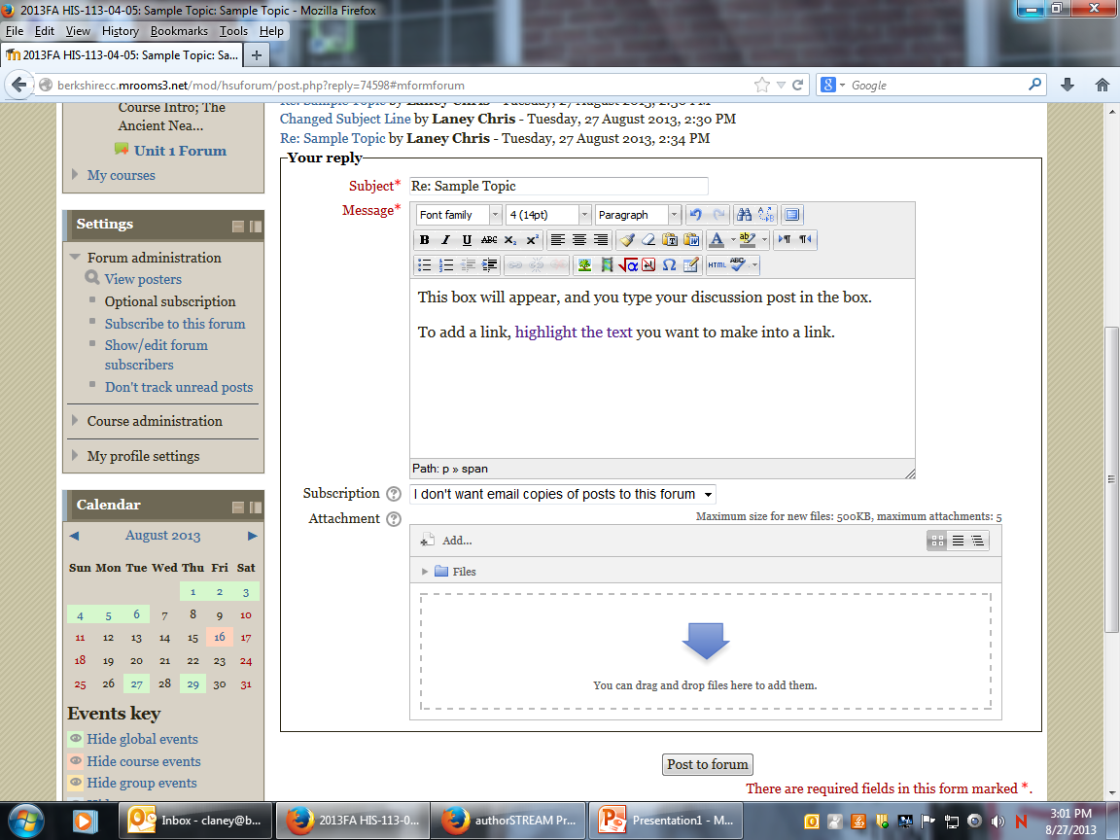

Slide 31
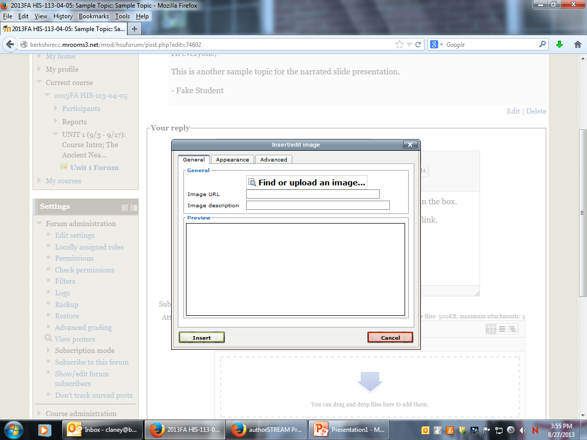

Slide 32
