Slide 1
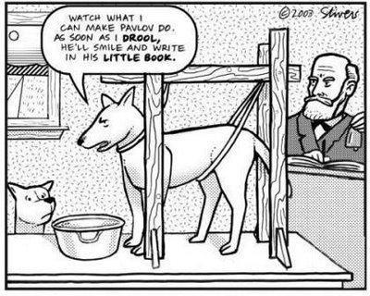
Critical Thinking Assessment Project

Slide 2
Assessment of Critical Thinking is part of larger effort
BCC Assessment Task Force:
Co-Chairs: Charles Prescott (English), Stacy Evans (Sociology)
Maura Delaney, English
Michele Darroch, Physical Therapy
Carlton Maaia, Hospitality Sciences Management
Faye Reynolds, Biology
Peggy Rivers, Fine Arts
Primary task: Streamline the Core Competency system for institutional level assessment and improvement of student outcomes

Slide 3
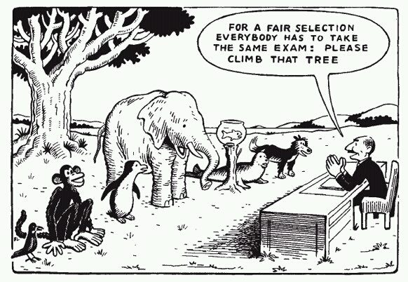
Why are we doing this again?

Slide 4
Critical Thinking Assessment
Registrar’s Office compiled a list of Fall 2013 courses that have Critical Thinking Competency embedded, as well as courses that frequently grant CC-CT.
Faculty teaching those courses were asked to collect and share student work from one assignment.
All student work from the assignment as well as the assignment sheet were submitted.
All identifying marks (student name, faculty name, course number) were removed before samples were shared with the scoring team.

Slide 5
Critical Thinking Assessment Project
251 samples from 12 courses
Samples came from:
Biology Math
Criminal Justice Nursing
English Visual Arts
History

Slide 6
Critical Thinking Scoring Team
\working with the rubric.
Faculty Member: | Subject Represented:
Aidan Clement | Anthropology
Michele Darroch | Physical Therapy
Traci Dundas | Mathematics
Joanne Heaton | Nursing
Chris Laney | History
Sherry Scheer | Physical Fitness
Julianna Spallholz | English

Slide 7
Scoring the Student Work
January 6-7 (about 10 hours total)
BCC Critical Thinking Rubric
Scored 150 student samples on Interpretation, Analysis and Evaluation
Possible scores: High, Acceptable, Insufficient, Not Attempted
Each sample was double-read. If necessary, scorers discussed the work to reach consensus.

Slide 8
Consensus was easy!

Slide 9
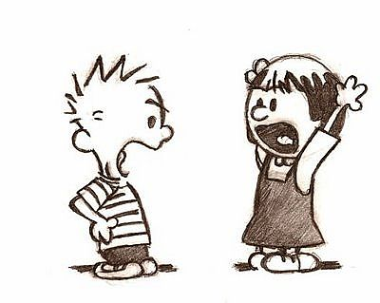
(mostly)

Slide 10
What we found (and Stacy analyzed!)
84% of samples achieved competency (either “acceptable” or “high”) on at least one competency (interpretation).
48% achieved competency in the analysis skill
27% of samples achieved competency in the evaluation skill.

Slide 11
Possible correlations from looking at assignment sheets
27% achieved competency for evaluation; however, among samples in which evaluation was explicit in the assignment sheet, this number jumps to 57% I
93% of assignments asked for interpretation; 84% achieved that competency
40% of assignments asked for evaluation; 27% achieved that competency.
No such correlation with analysis skill: 86% of assignments required this skill; 48% of samples achieve it. (Wide variety of ways in which “analysis” is used in assignments).

