Slide 1
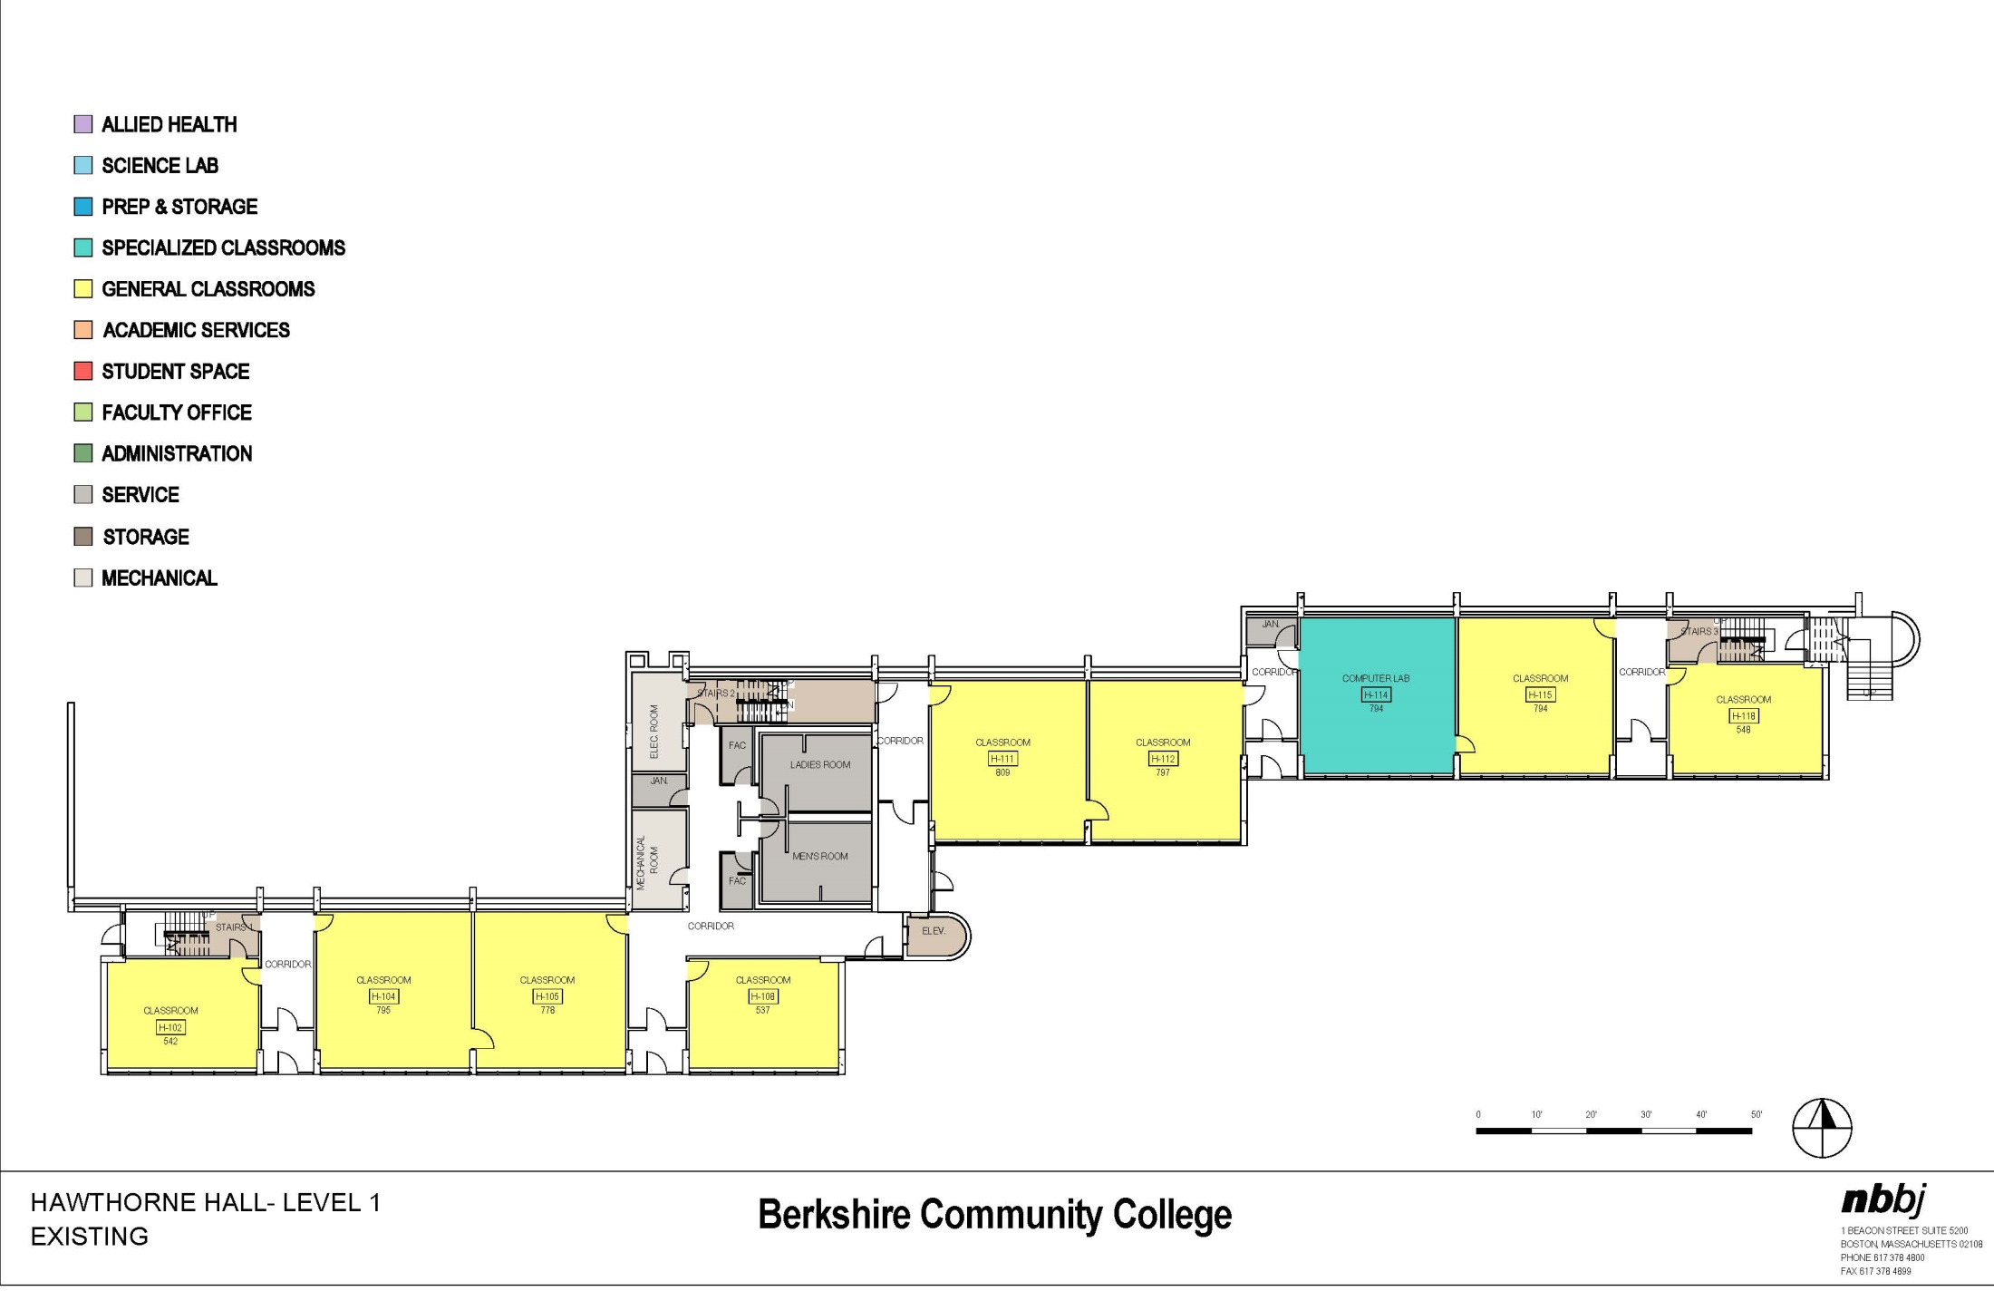
Hawthorne Hall – LEVEL 1
EXISTING

Slide 2
Hawthorne Hall – LEVEL 1
PROPOSED

Slide 3
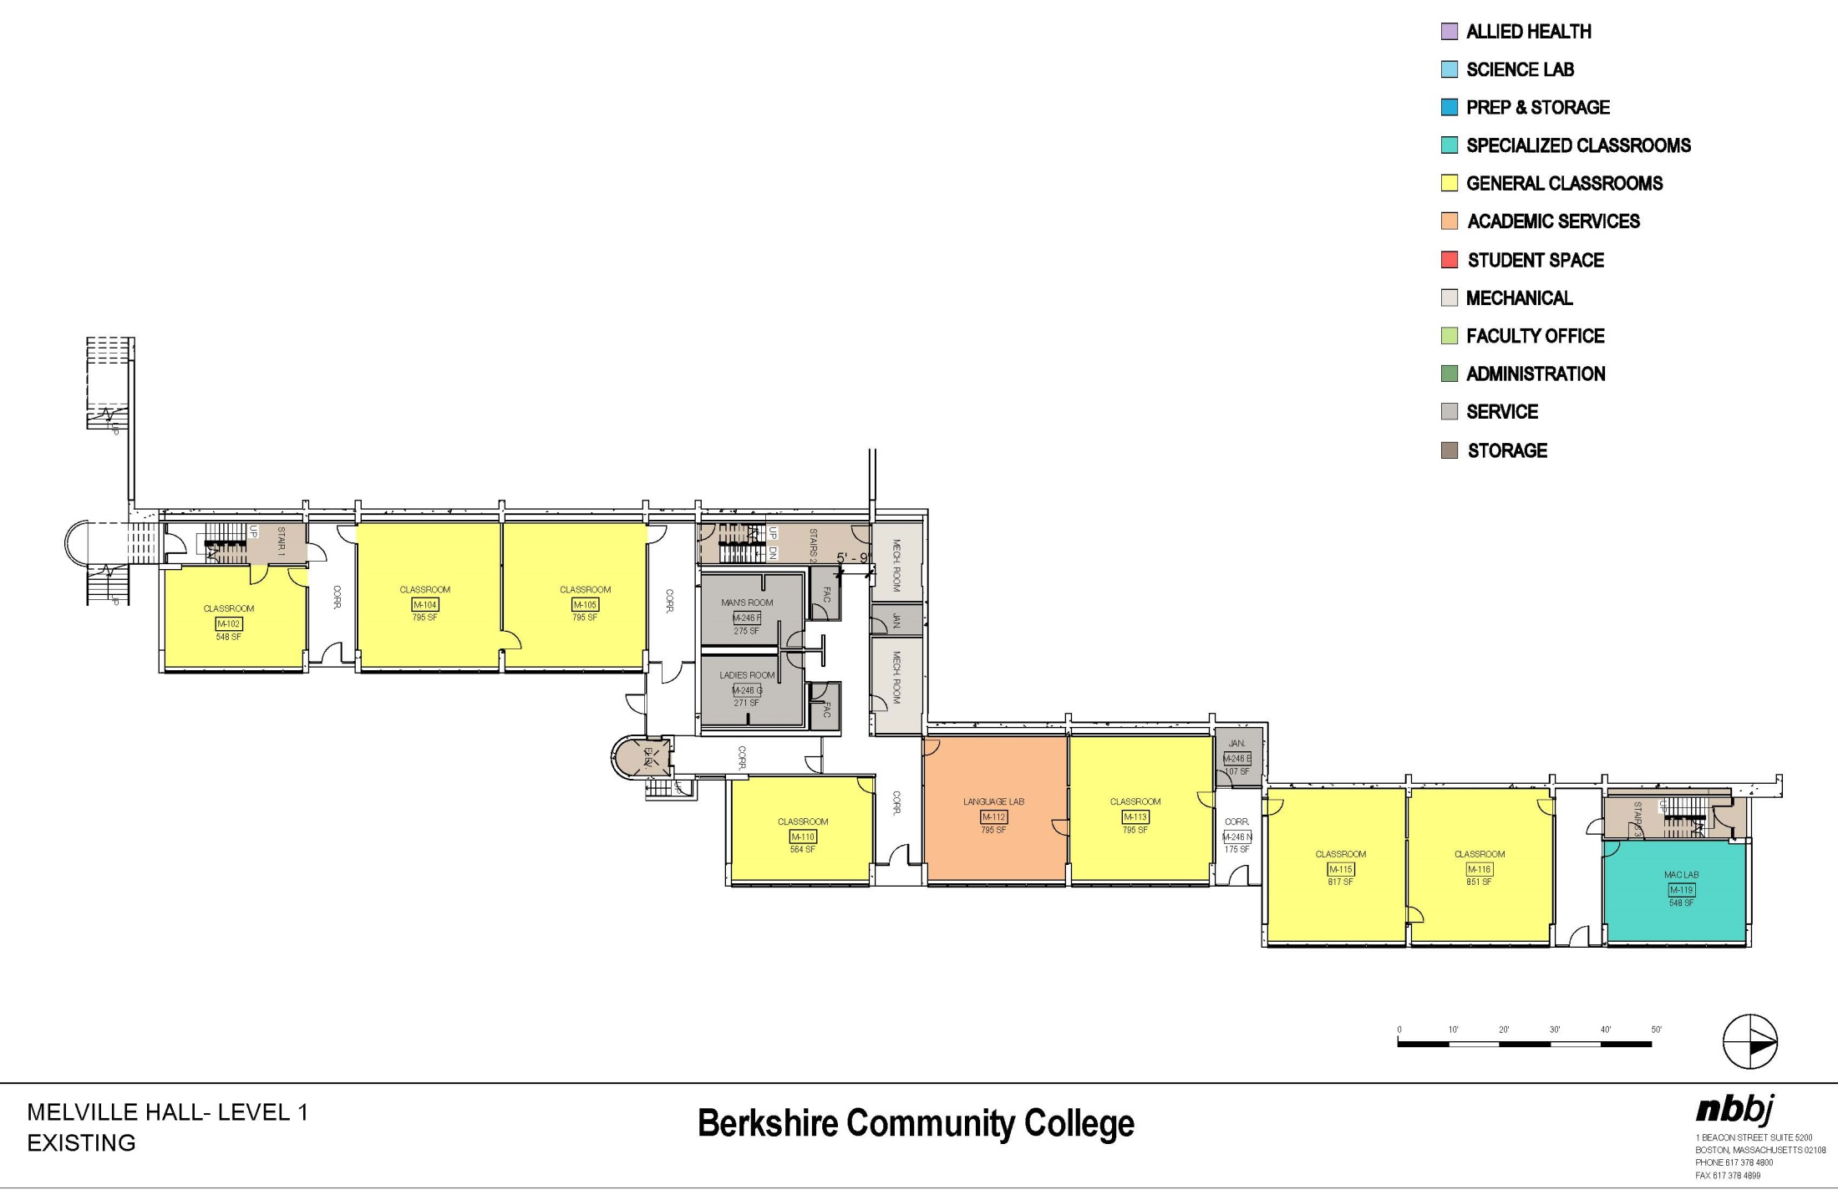
Melville Hall – LEVEL 1
EXISTING

Slide 4
Melville Hall – LEVEL 1
PROPOSED

Slide 5
Hawthorne Hall – LEVEL 2
EXISTING

Slide 6
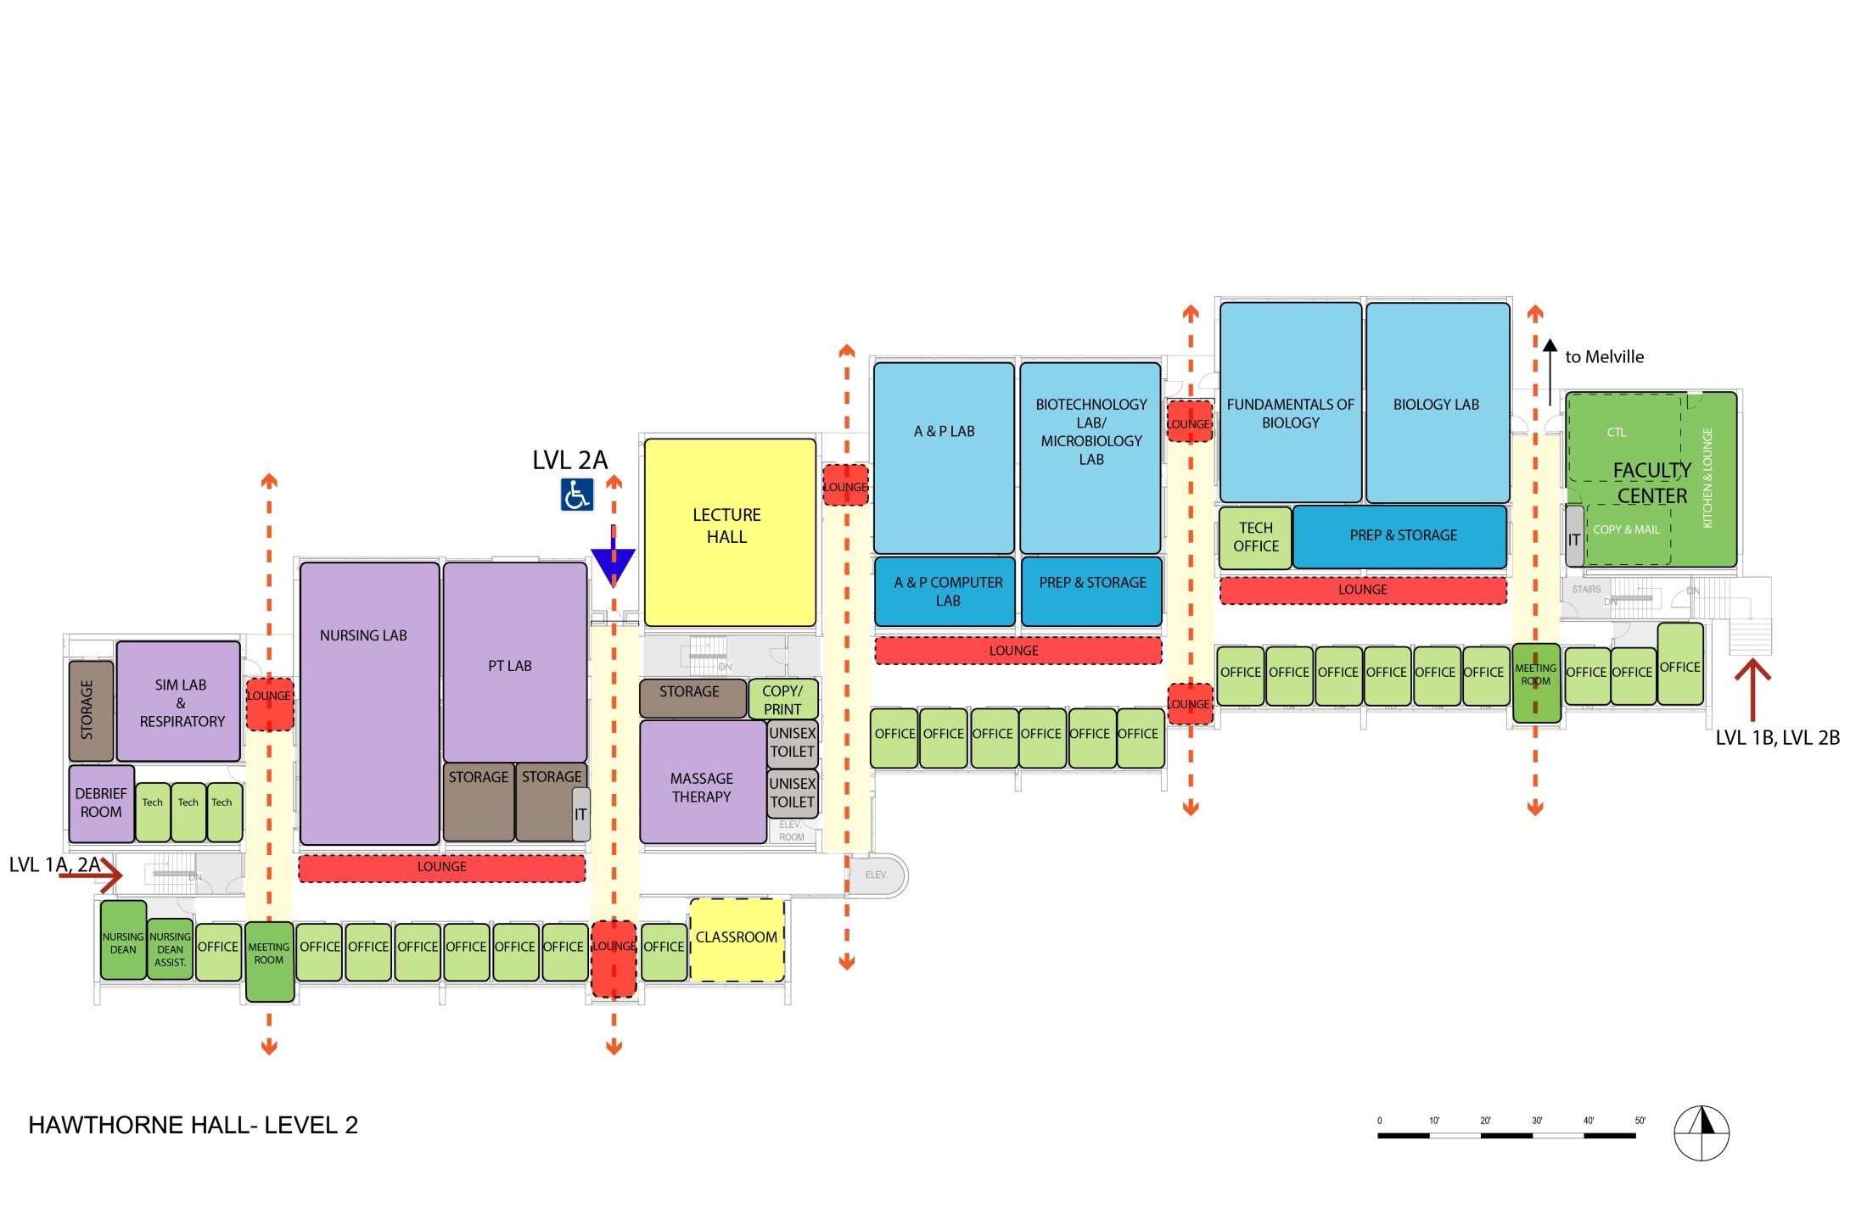
Hawthorne Hall – LEVEL 2
SCIENCE LABS
ALLIED HEALTH
PROPOSED

Slide 7
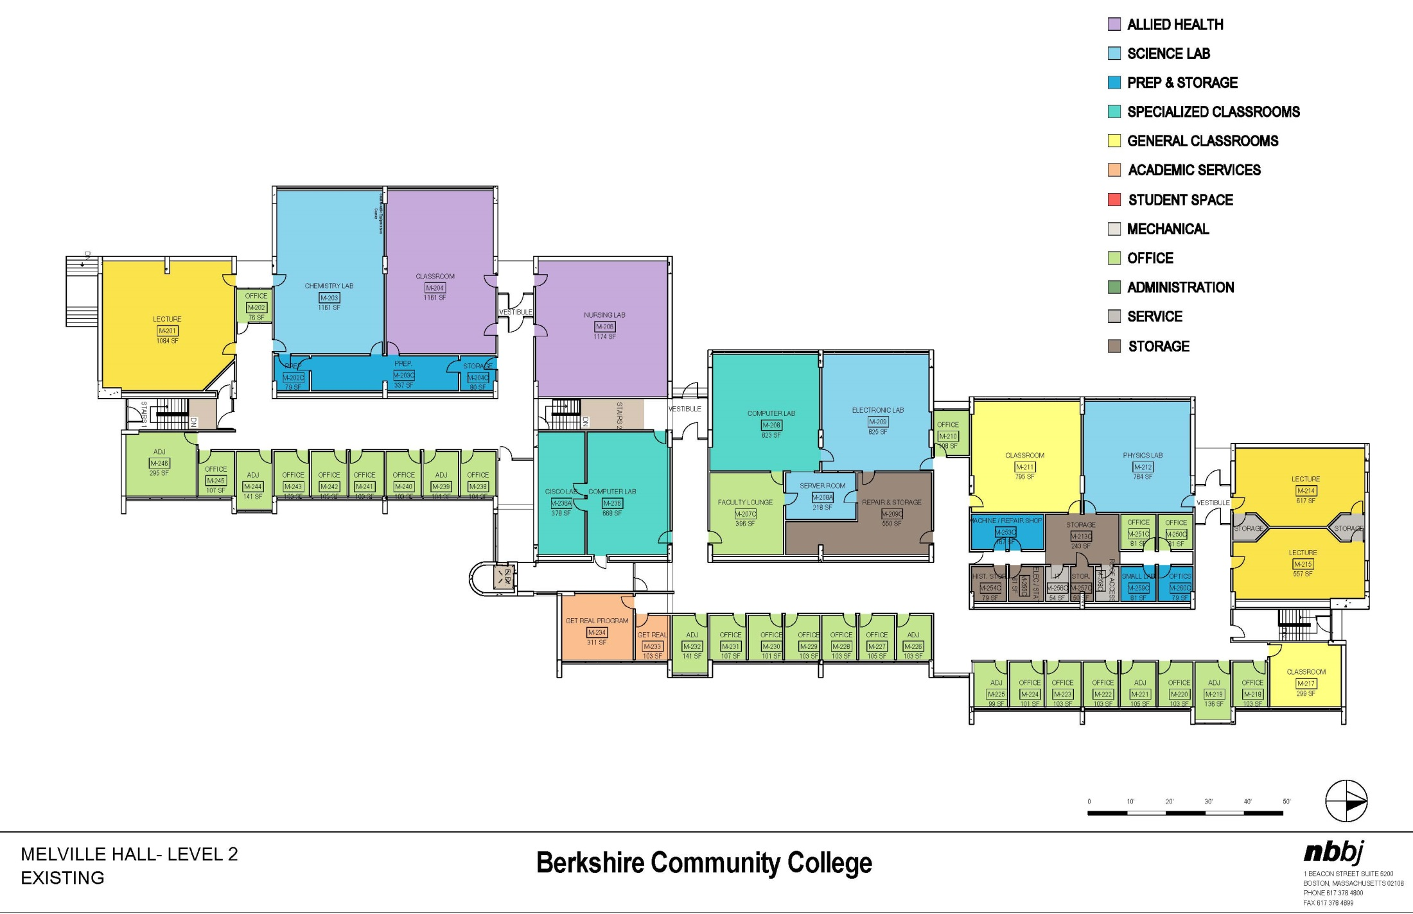
Melville Hall – LEVEL 2
EXISTING

Slide 8
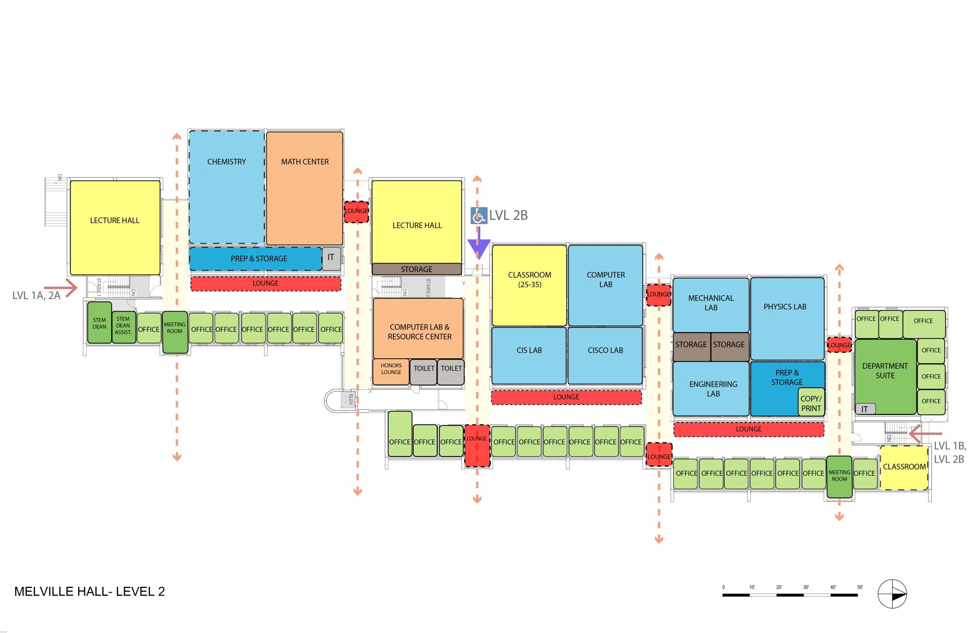
Melville Hall – LEVEL 2
SCIENCE LAB
COMPUTER SCIENCE
PHYSICS & ENGINEERING LABS
DEPARTMENT SUITE
PROPOSED

Slide 9
Connector
PROPOSED

Slide 10
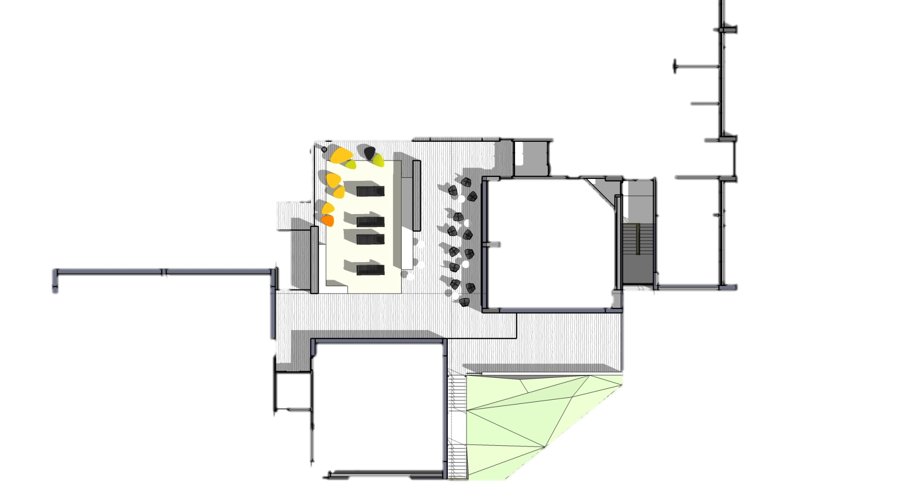
PROPOSED
MELVILLE
FIELD
HAWTHORNE
N
KOUSSEVITZKY

Slide 14
Summary
Faculty Center | Includes Center For Teaching & Learning, Kitchen, Printer & Copier, Mail Additional Printer & Copier Included In Each Building
Faculty Offices | 50
Connection | Connection With Lounge Toward Fire Road (Includes Community Lounge, Café, Math Center & Faculty Center )
Classrooms
1-15 | 2
16-25 | 9
26-35 | 9
36-50 | 0
51-100 | 3
Total | 23
Mechanical Lab | Yes
Computer Labs
CISCO Lab | 1
CIS Lab | 1
General Teaching Computer Lab | 1 (+2 In Koussevitzky)
Melville Hall (Center) | Computer Lab & Resource Center

Slide 15
Koussevitzky - LEVEL 1
EXISTING ART ROOMS

Slide 16
Koussevitzky - LEVEL 2

Slide 17
