Slide 1
27/01/2014

Slide 2
VISION & GOALS Dynamic Teaching & Learning Environment Warm, Welcoming, Inviting Attractive to Prospective Students Improve Wayfinding, Accessibility Clarity, Identity Better Connections Confidence, Possibility Sustainability Infrastructure Others?

Slide 3
ALTERNATIVE CONCEPTS
Office Space
Programming for Central Space in Melville
General Classrooms
Sciences
Computer Science & Engineering
Nursing
Student Programs

Slide 4
OFFICE SPACE

Slide 5
Melville Hall –Level 2

Slide 6
Hawthorne Hall –Level 2

Slide 7
Field Admin–Level 2

Slide 8
Koussevitzky–Level 2

Slide 9
Office Space
EXISTING OFFICES | Hawthorne | Melville | Total
Full-Time Faculty | 24 | 18 | 42
Adjunct Stations | 38 | 49 | 87
Technicians Offices | 2 | -
Empty Offices | - | 2
Workspace | 1 | 1 | 2
PROPOSED PLANS | Hawthorne | Melville | Total
Full-Time Faculty | 21 | 21 | 42
Adjunct Stations | 28 | 56 | 84
Nurse Office | 4 |  | 4
Empty Offices | - |  | 0
Workspace | 1 | 1 | 2

Slide 10
Option 1: Office Space in Hawthorne
HAWTHORNE OFFICE INVENTORY
21 FACAULTY OFFICES
2 DEAN OFFICES
2 ASSISTANT DEAN OFFICES
28 ADJUNCT STATIONS
4 NURSING ADJUNCT/TECH STATIONS
2 MEETING ROOMS
Faculty Work Room
Meeting Room
Meeting Room
STEM Dean
Adjunct office
7 Stations
4 Assigned per Station
Nursing Dean

Slide 11
Option 1: Office Space in Melville
MELVILLE OFFICE INVENTORY
21 FACAULTY OFFICES
56 ADJUNCT STATIONS
4 ACADEMIC SERVICES OFFICES
2 MEETING ROOMS
Academic Services Offices
Faculty Work Room
Adjunct office
7 Stations
4 per Station
Adjunct office
7 Stations
4 per Station
Meeting Room
Meeting Room

Slide 12
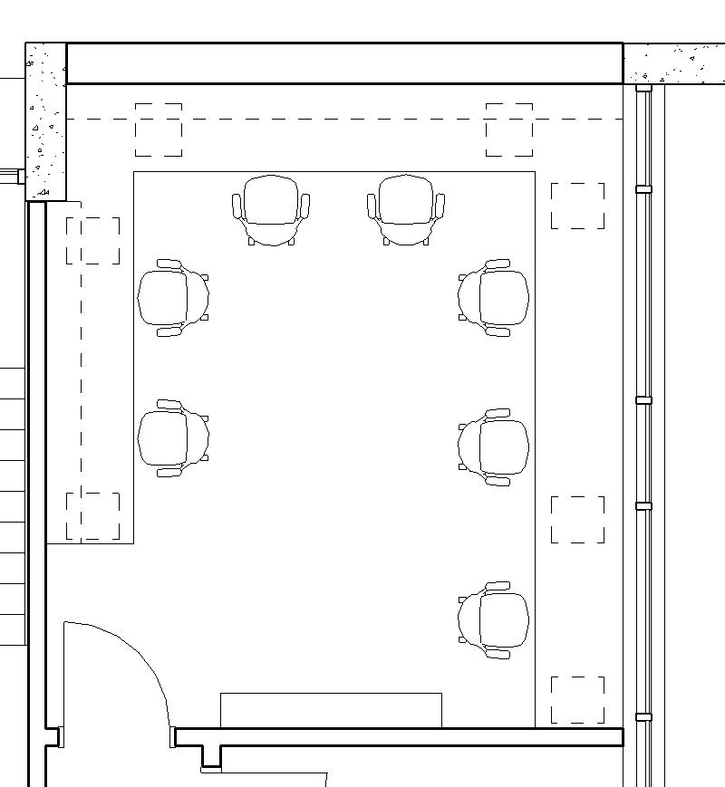
Adjunct Office Space
Option 1: Linear
Option 2: Wrapper

Slide 13
Option 2: Office Space in Hawthorne
HAWTHORNE OFFICE INVENTORY
21 FACAULTY OFFICES
1 DEAN OFFICES
1 DEAN ASSISTANT OFFICE
56 ADJUNCT STATIONS
4 NURSING ADJUNCT/TECH STATIONS
2 MEETING ROOMS
Adjunct office
7 Stations
4 Assigned per Station
Meeting Room
Meeting Room
Faculty Room
Adjunct office
7 Stations
4 Assigned per Station
Nursing Dean

Slide 14
Option 2: Office Space in Melville
MELVILLE OFFICE INVENTORY
21 FACAULTY OFFICES
1 DEAN OFFICE
1 DEAN ASSISTANT OFFICE
28 ADJUNCT STATIONS
4 ACADEMIC SERVICES OFFICES
2 MEETING ROOMS
Academic Services Offices
Adjunct office
7 Stations
4 per Station
Dean of STEM
Meeting Room
Faculty Work Room
Meeting Room

Slide 15
Offices: Option 2A- Additional Adjunct Offices
MELVILLE OFFICE INVENTORY
21 FACAULTY OFFICES
1 DEAN OFFICES
60 ADJUNCT STATIONS
4 ACADEMIC SERVICES OFFICES
2 MEETING ROOMS
Academic Services Offices
Adjunct office
8 Stations
4 per Station
Adjunct office
7 Stations
4 per Station
STEM Dean
Meeting Room
Faculty Room
Meeting Room

Slide 16
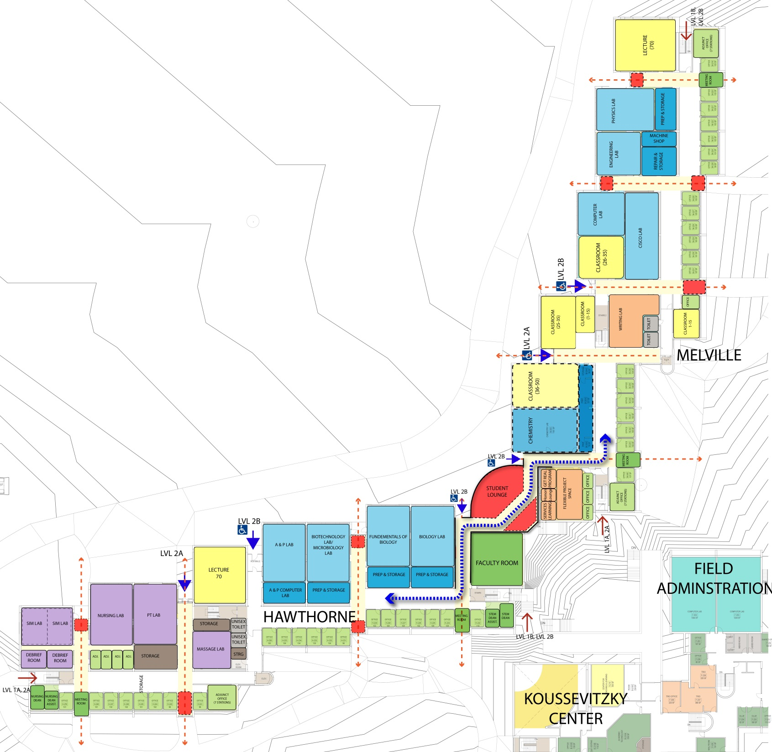
Option 3: Centralized Office Space & Lounge at Connector

Slide 17
Option 3: Centralized Office Space & Lounge at Connector
STUDENTS
Academic
CENTER
Faculty Center
Kitchenette, Mail,
Copy/Print, Meeting Room

Slide 18
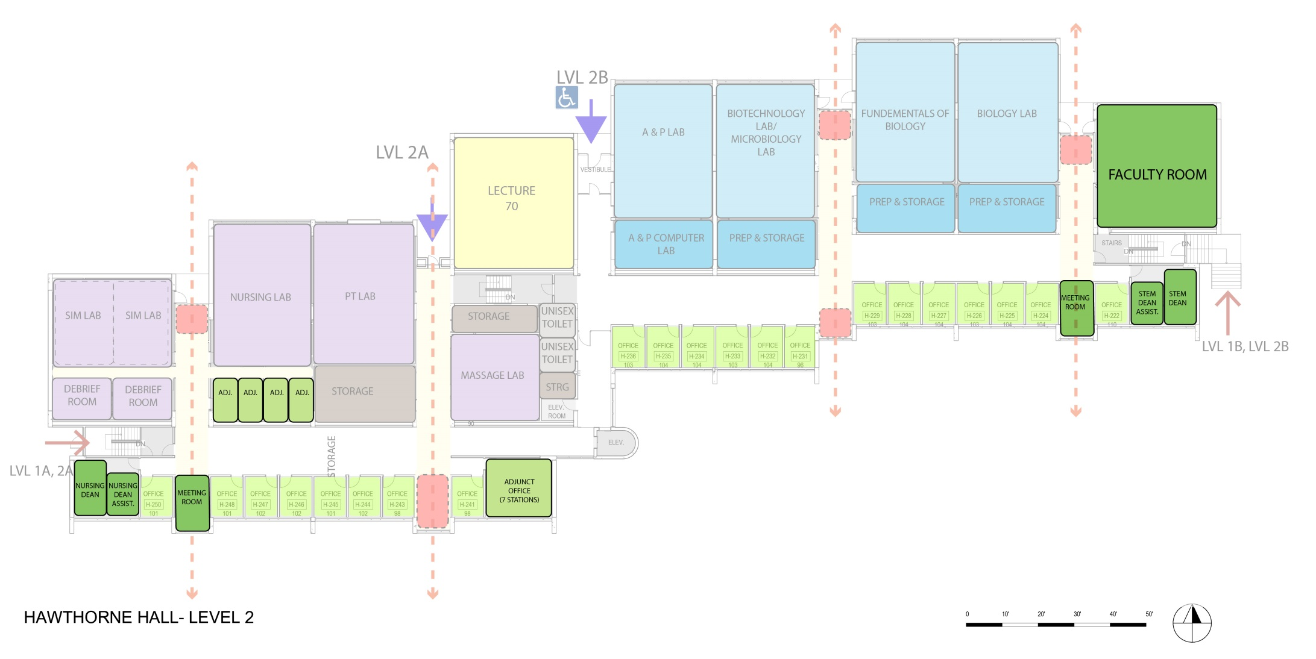
Option 3: Centralized Office Space & Lounge at Connector Offices: Option 3- Centralized Services
Faculty Center
Kitchenette, Mail,
Copy/Print, Meeting Room
Meeting Room
STEM Dean
Adjunct office
7 Stations
4 Assigned per Station
Nursing Dean
Meeting Room

Slide 19
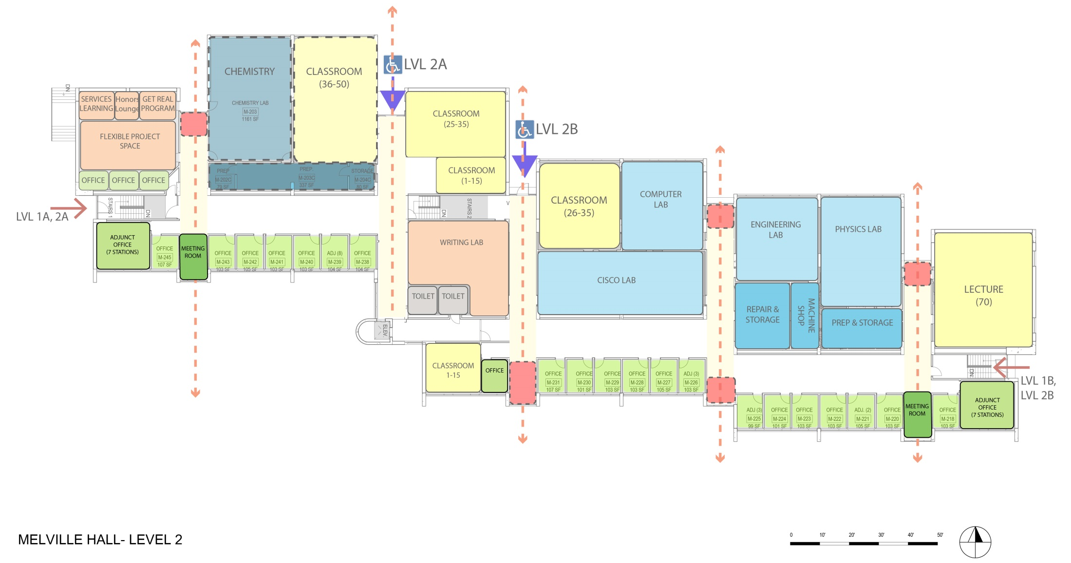
Offices: Option 3- Centralized Services
Academic Services Offices
Adjunct office
7 Stations
4 per Station
Adjunct office
7 Stations
4 per Station
Meeting Room
Meeting Room

Slide 20
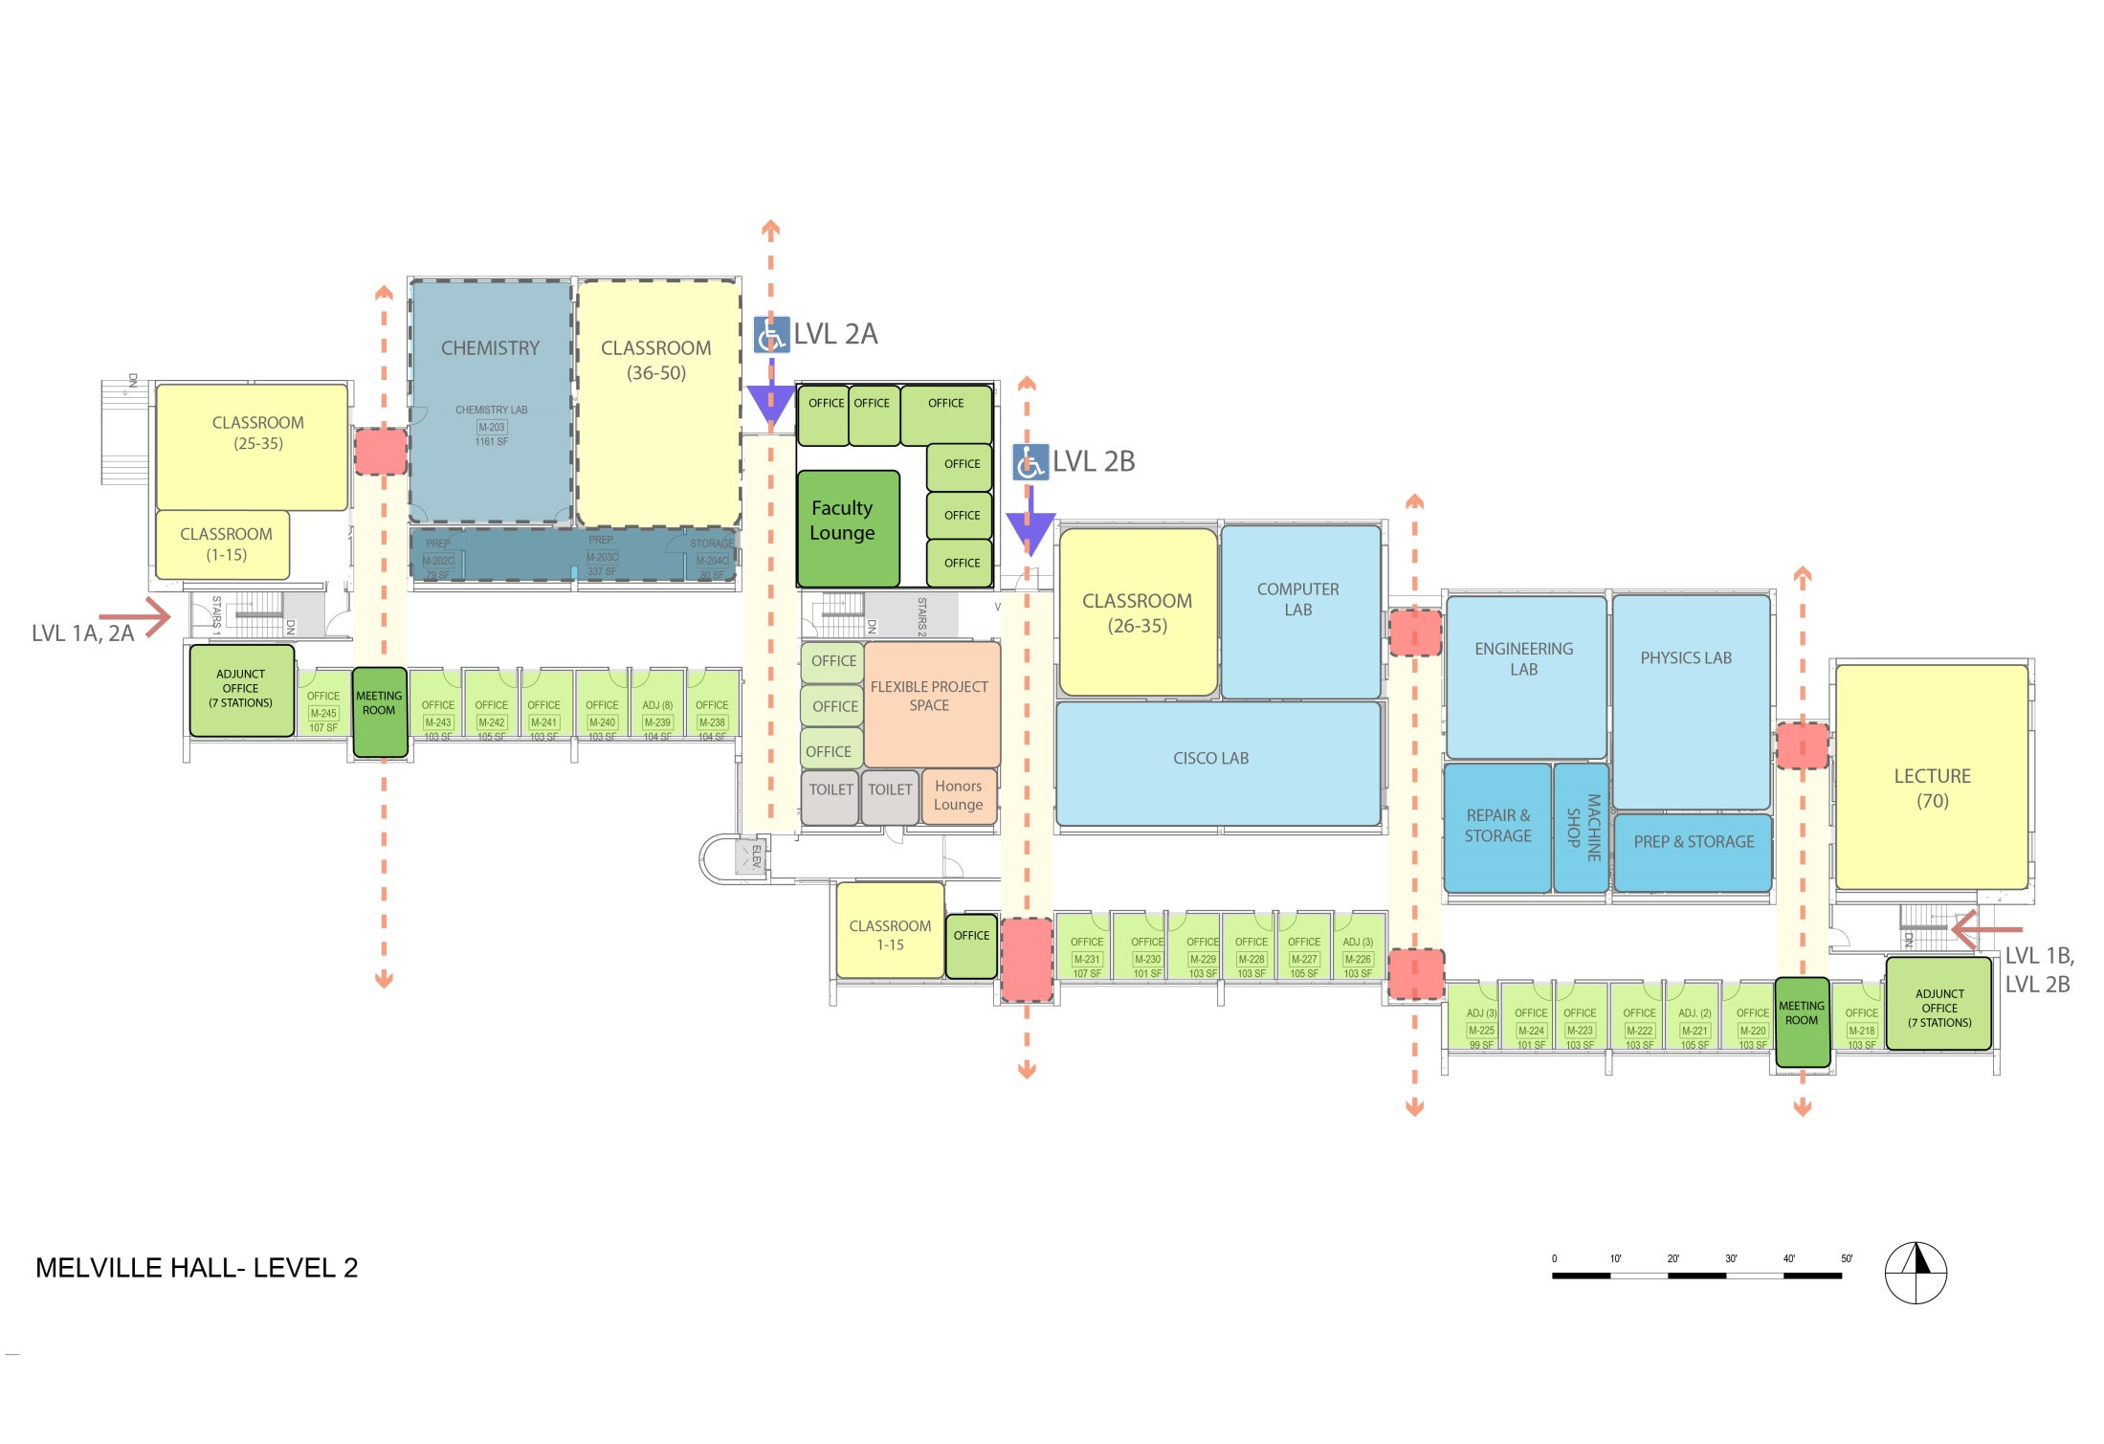
Offices: Option 4- Additional Offices In Melville
Faculty Work Room
6 Additional Faculty Offices
Adjunct office
7 Stations
4 per Station
Adjunct office
7 Stations
4 per Station
Meeting Room
Student Programs
Meeting Room

Slide 21
Offices: Option 4- Additional Offices In Melville
HAWTHORNE OFFICE INVENTORY
21 FACAULTY OFFICES
1 DEAN OFFICES
1 ASSISTANT DEAN OFFICES
14 ADJUNCT STATIONS
4 NURSING ADJUNCT/TECH STATIONS
2 MEETING ROOMS
Adjunct office
7 Stations
4 Assigned per Station
Meeting Room
Meeting Room
Faculty Room
Adjunct office
7 Stations
4 Assigned per Station
Nursing Dean

Slide 22
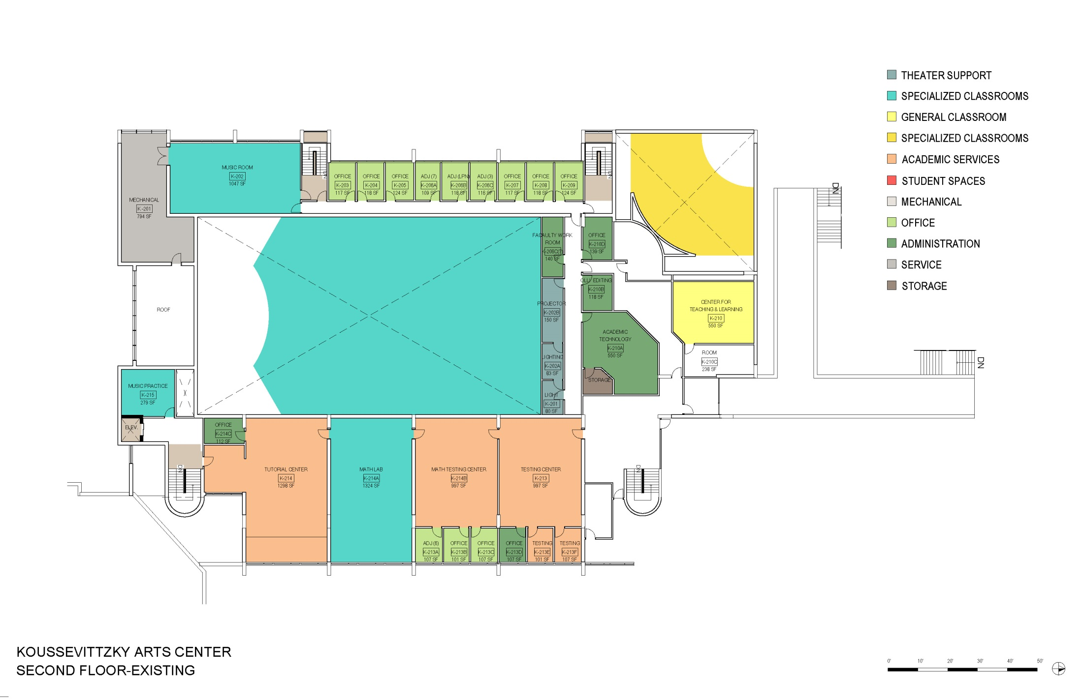
Additional Offices : Koussevitzky

Slide 23
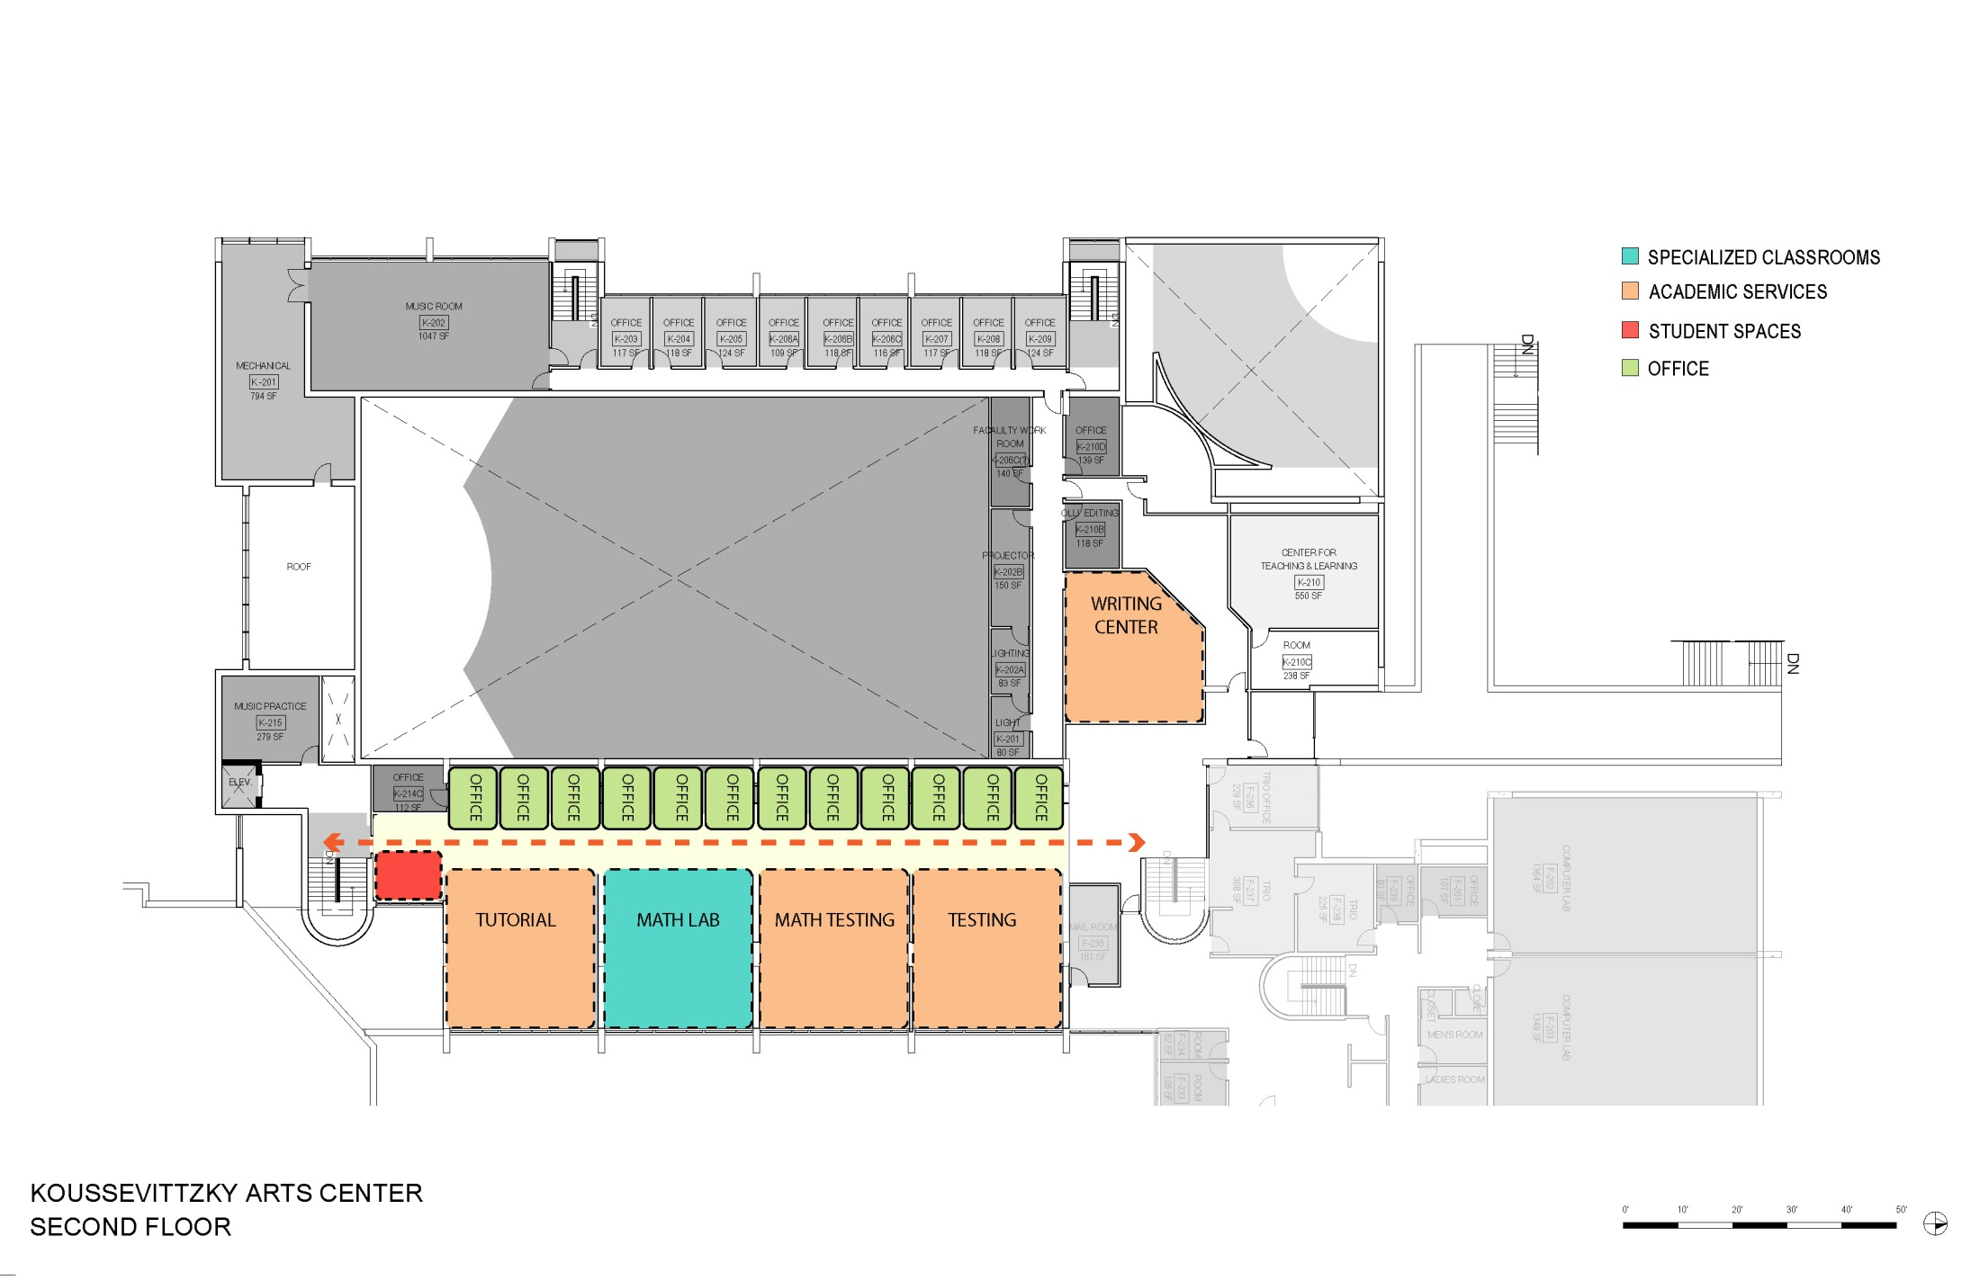
Additional Offices : Koussevitzky
6 Additional Offices

Slide 24
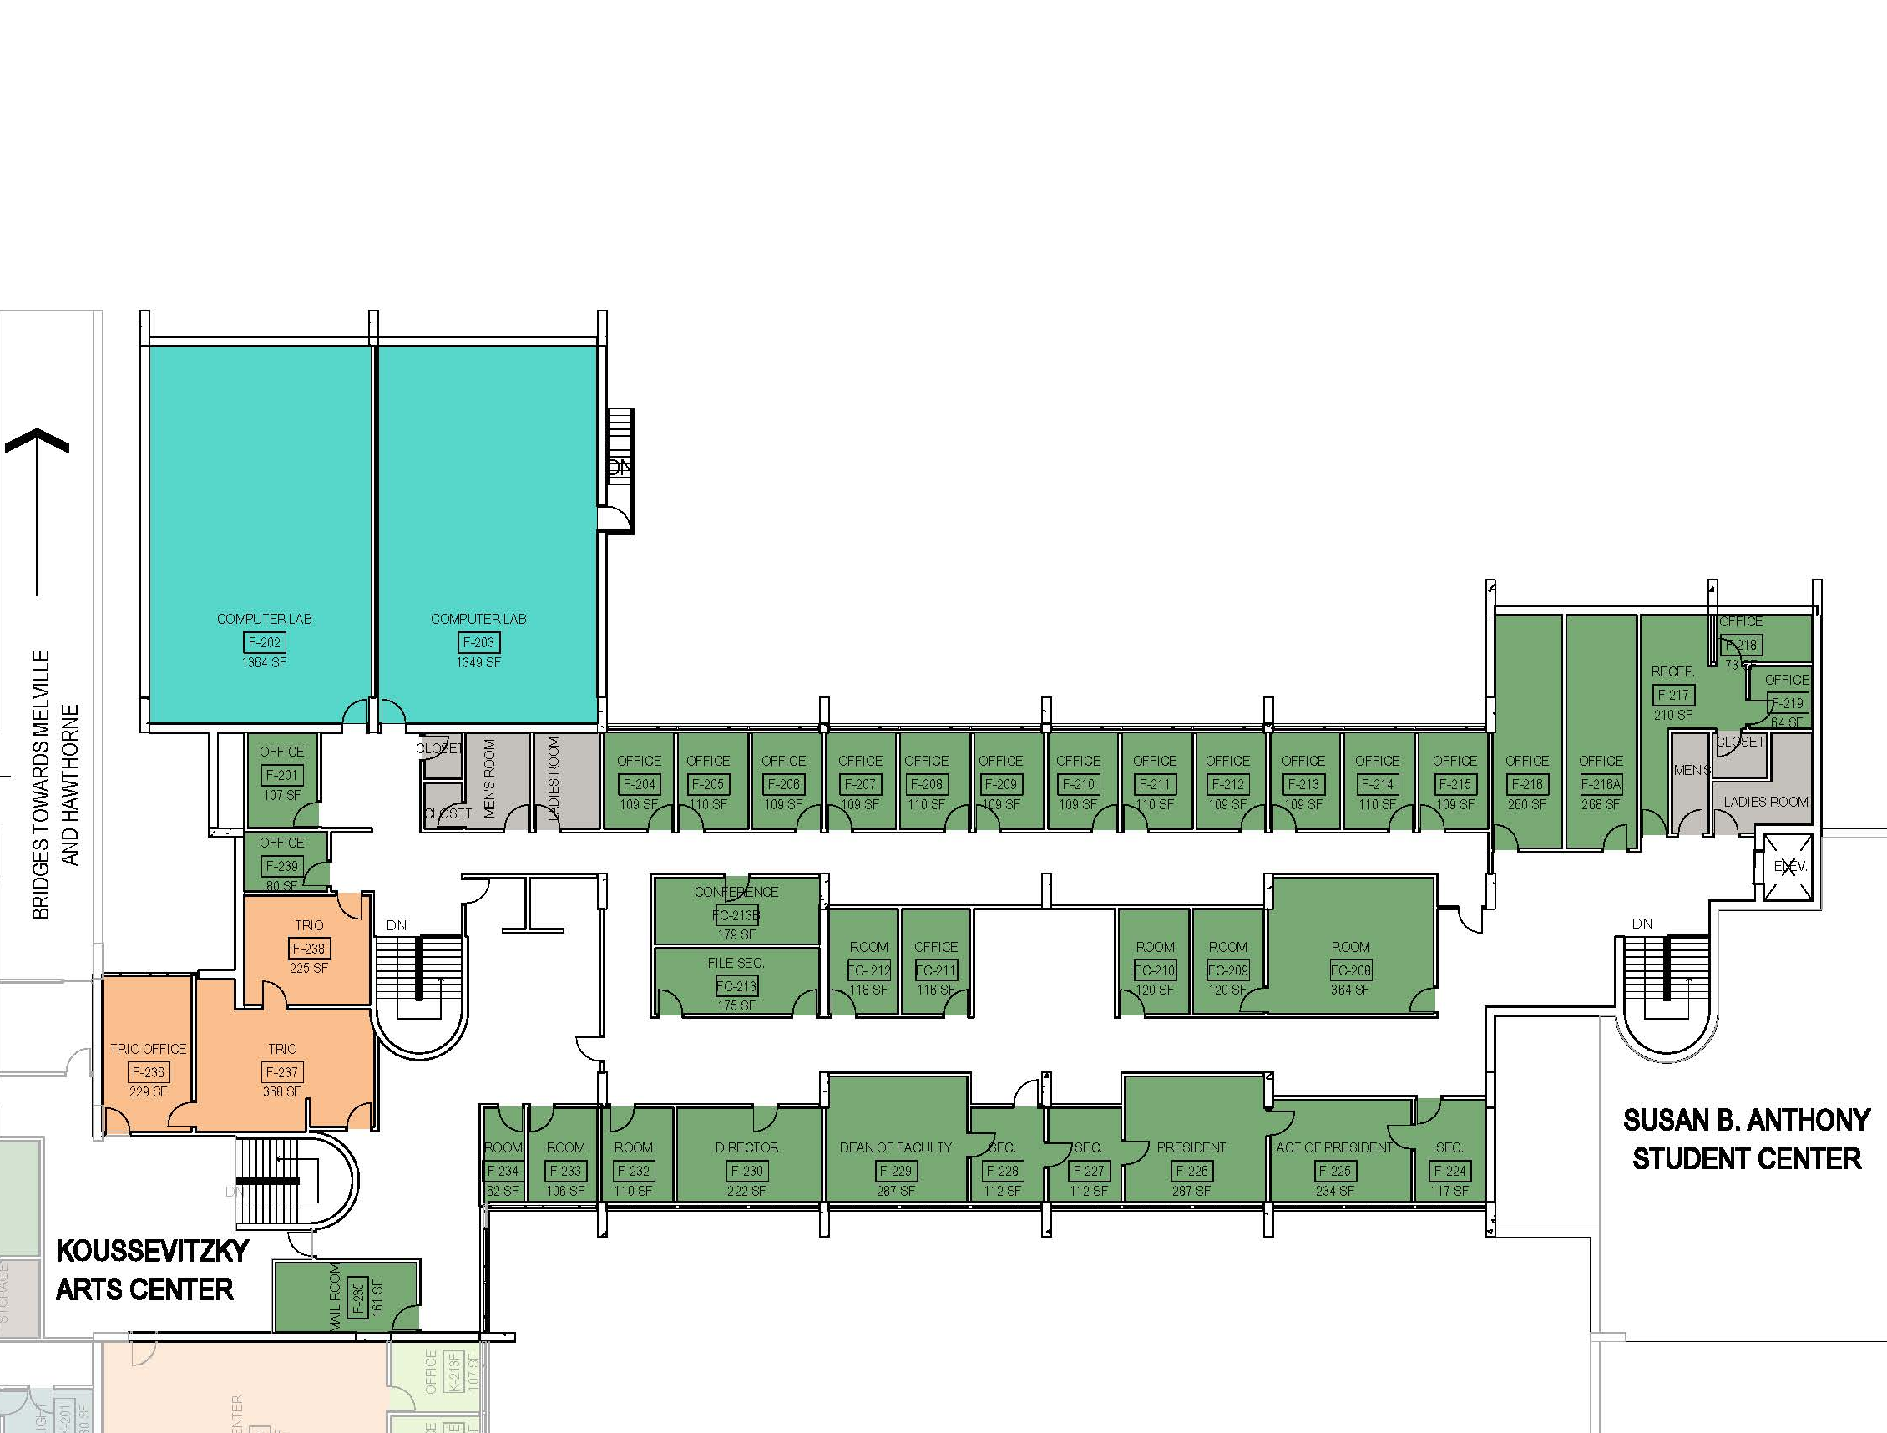
Additional Offices : Field Administration Office
4 Empty offices due to Dean’s relocating

Slide 25
PROGRAMMING
CENTRAL SPACE
IN MELVILLE

Slide 26
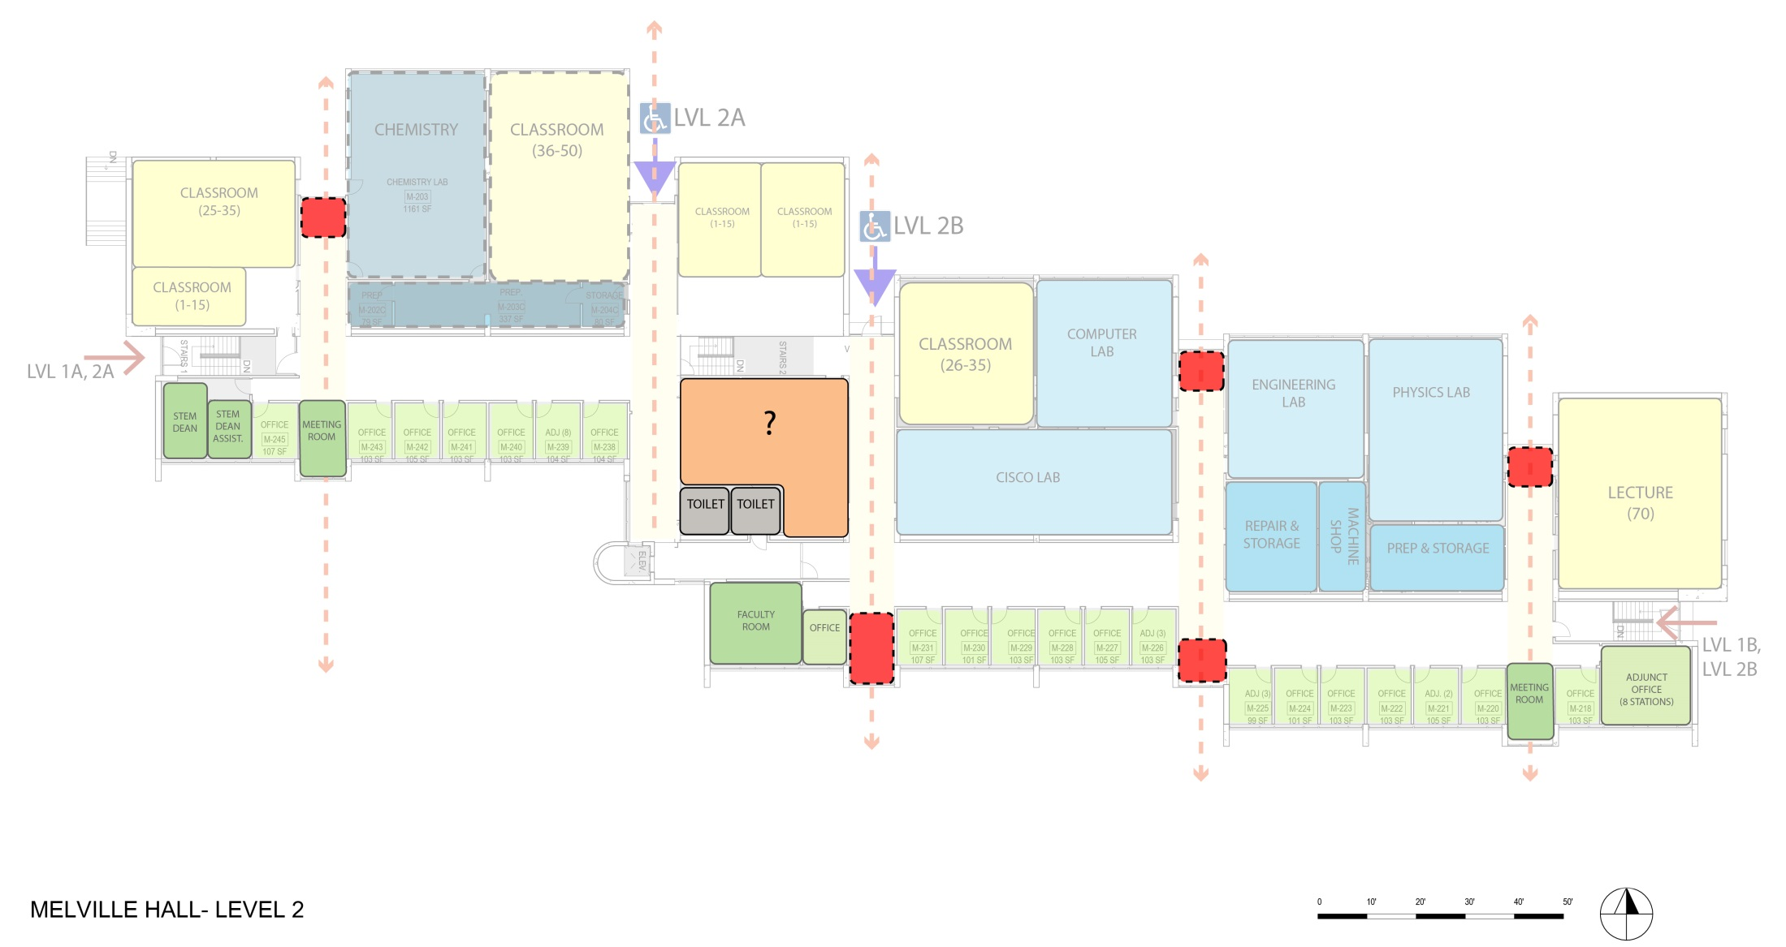
Central Space in Melville: What Could it Be?
Student Lounge
Writing Center
Student Lounge
Open Computer Lab
Academic Services
Meeting Room
Center for Academic Technology
Studio Classroom
Plus New Toilets
Other use?

Slide 27
Computer Labs: Field Administration Building
Relocating Labs ?
Testing ?
Tutoring?

Slide 28
GENERAL CLASSROOMS

Slide 29
Classrooms Overview

Slide 30
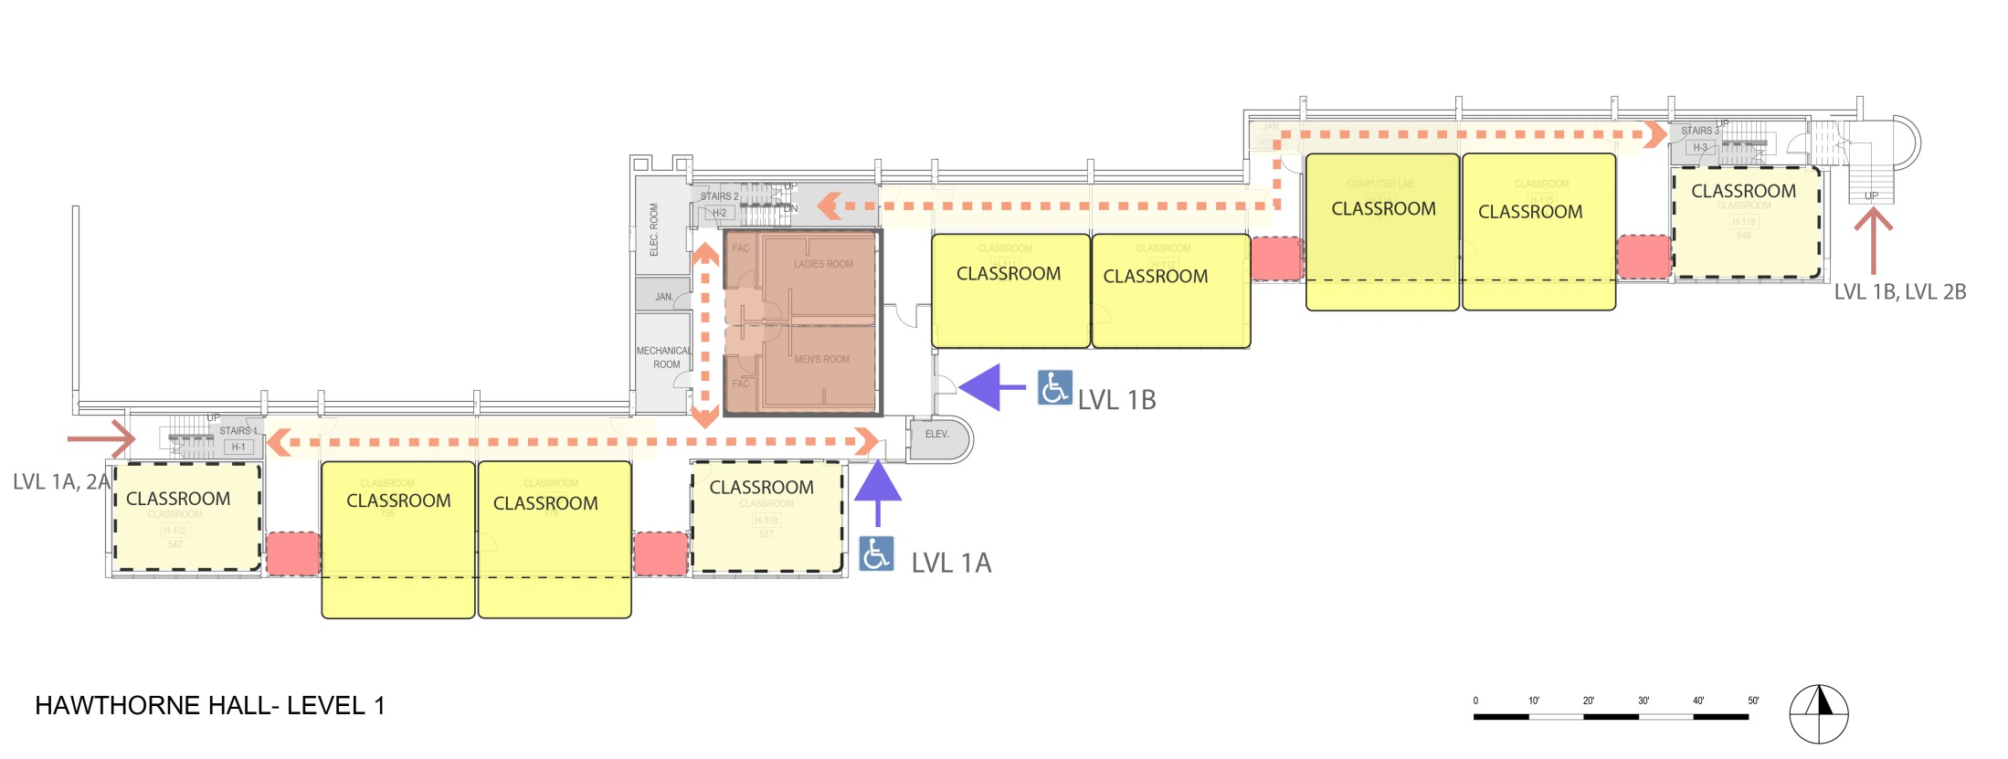
Hawthorne Level 1 Classrooms
1-15 x
16-25 5
26-35 4
36-50 x
51-100 x
9

Slide 31
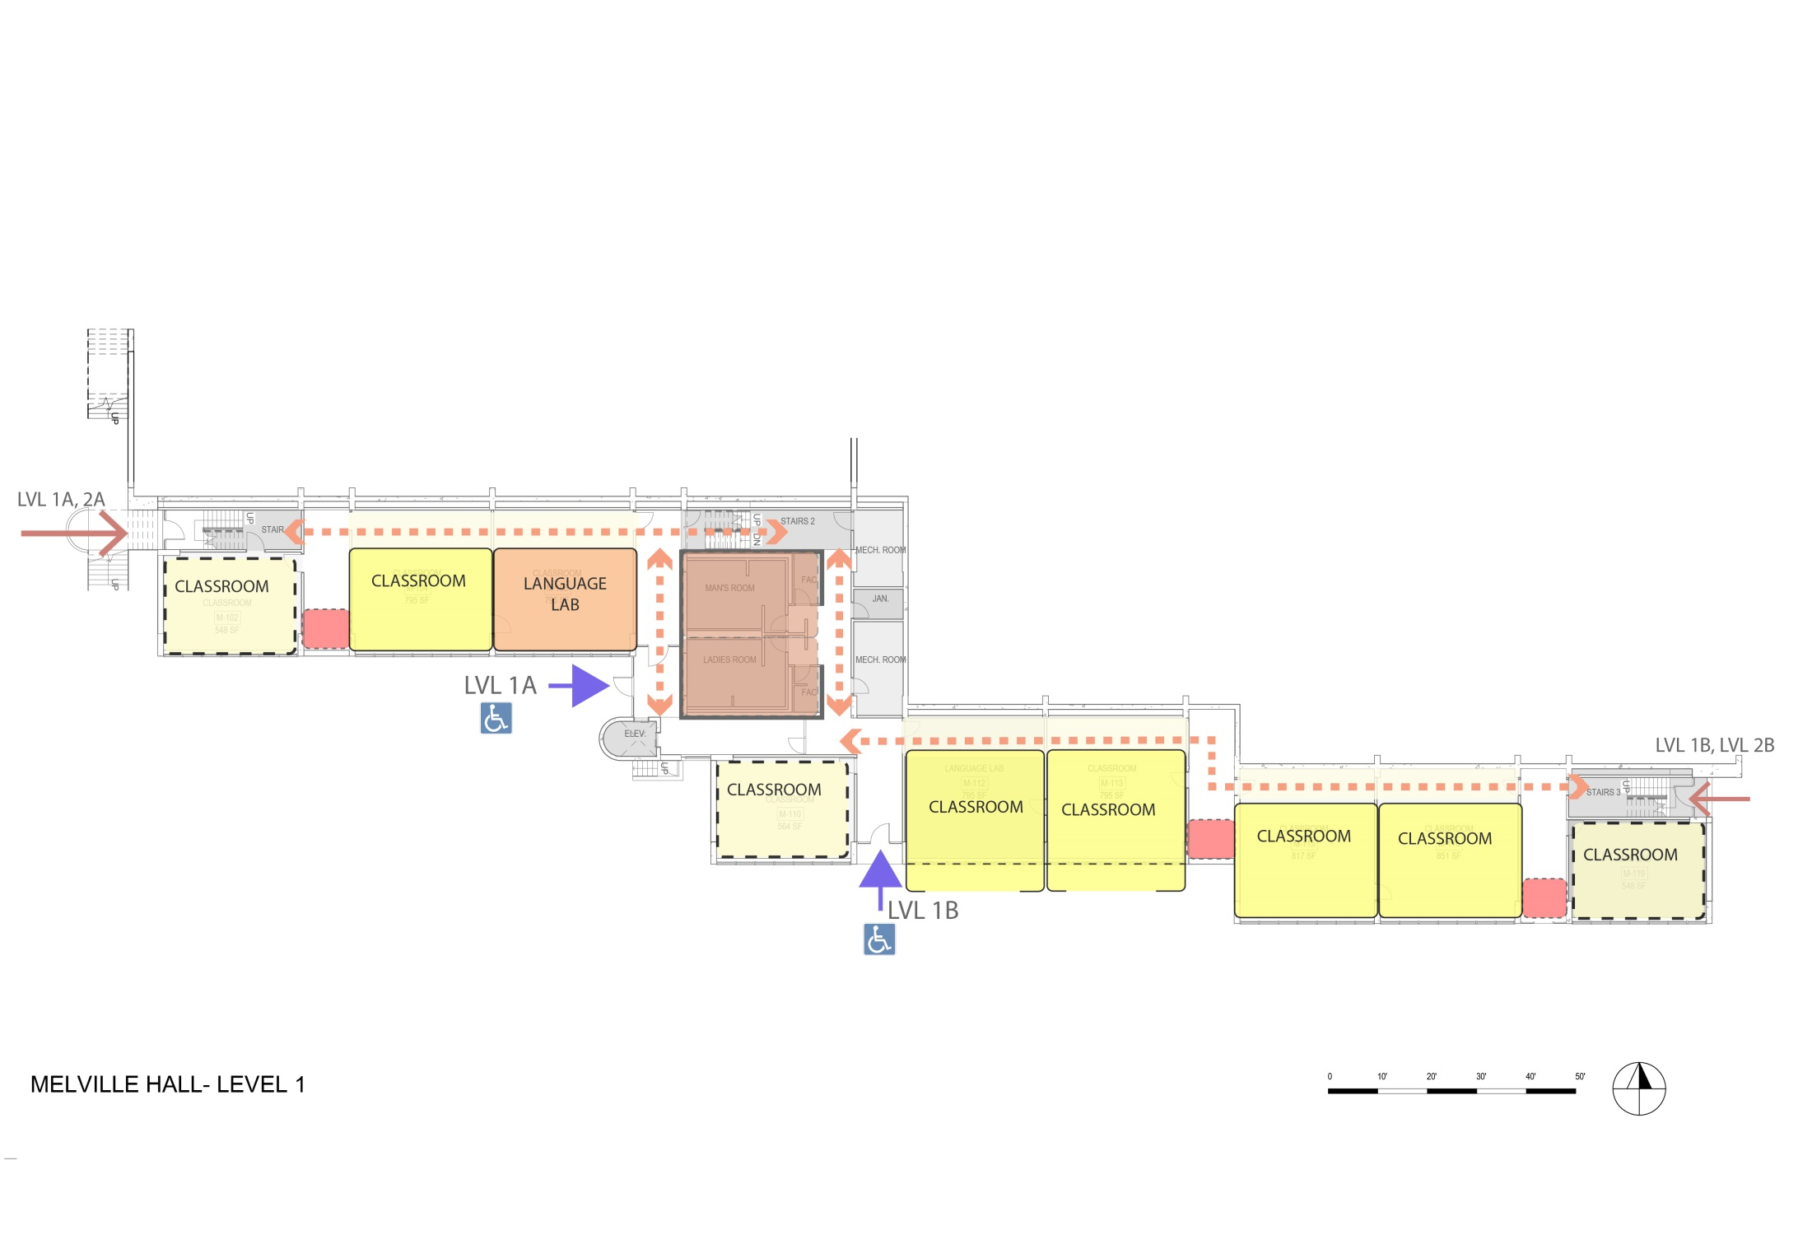
MELVILLE Level 1 Classrooms
1-15 x
16-25 6
26-35 2
36-50 x
51-100 x
8

Slide 32
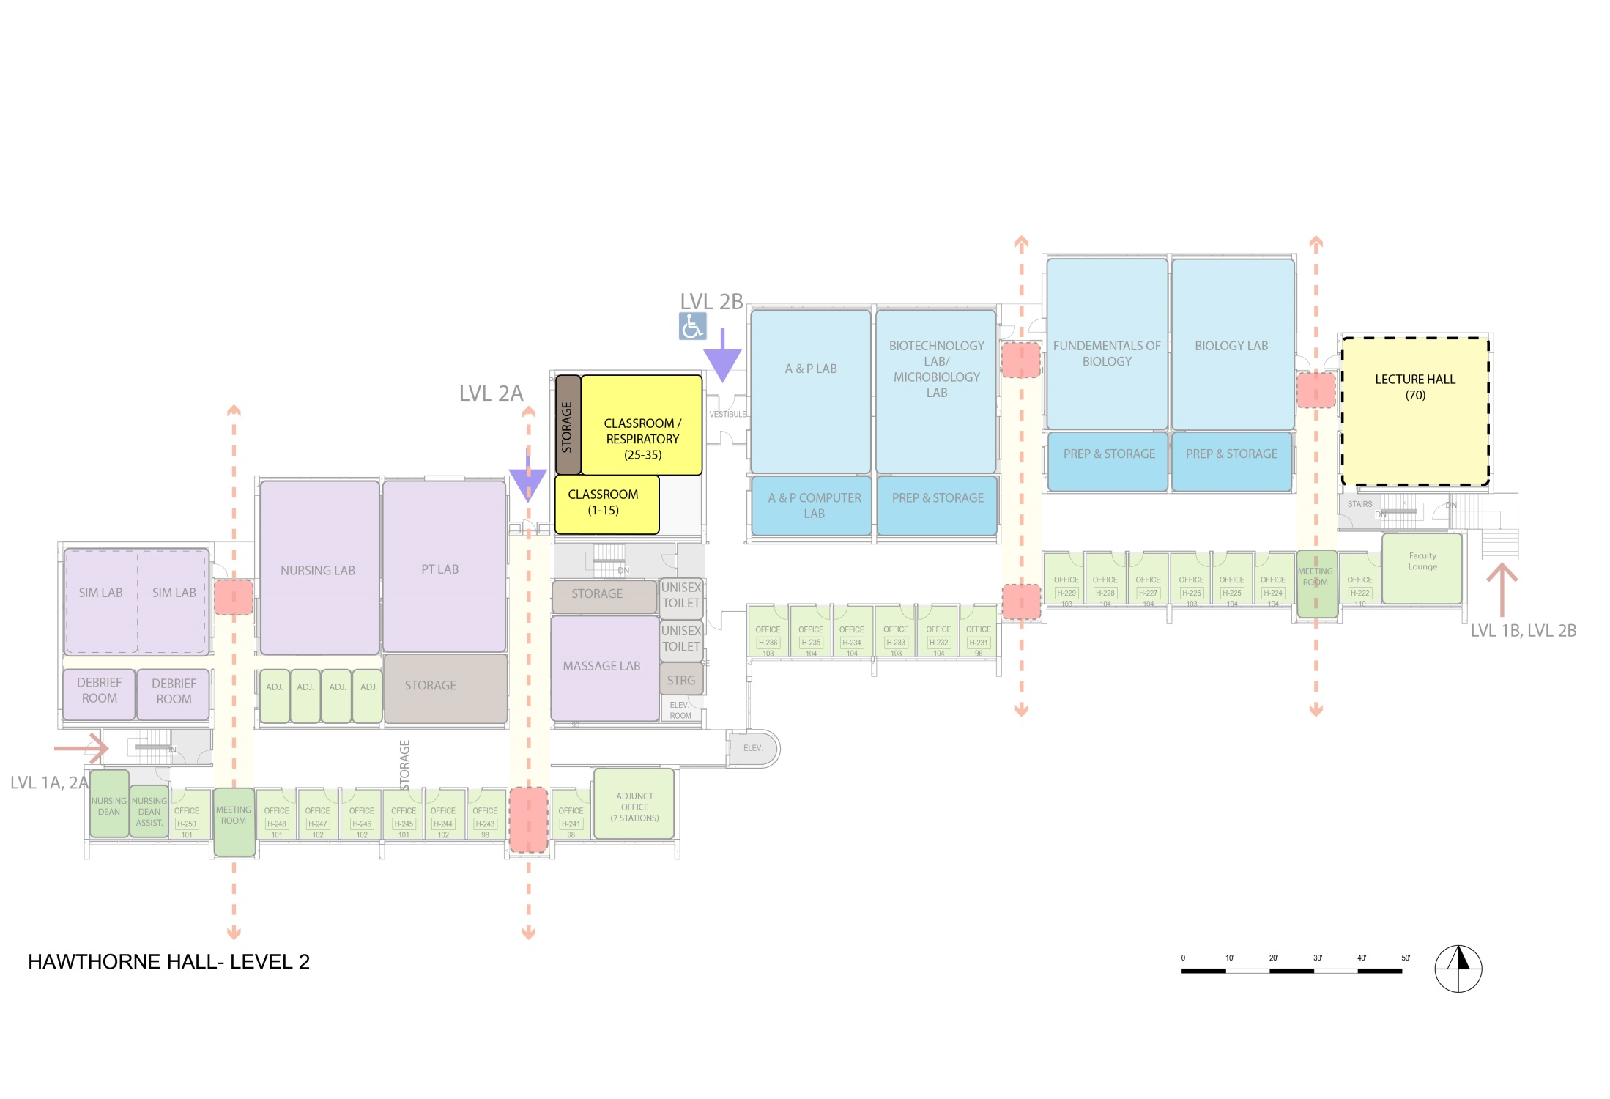
Option 1
Hawthorne Level 2 Classrooms
1-15 1
16-25 x
26-35 1
36-50 x
51-100 1
3

Slide 33
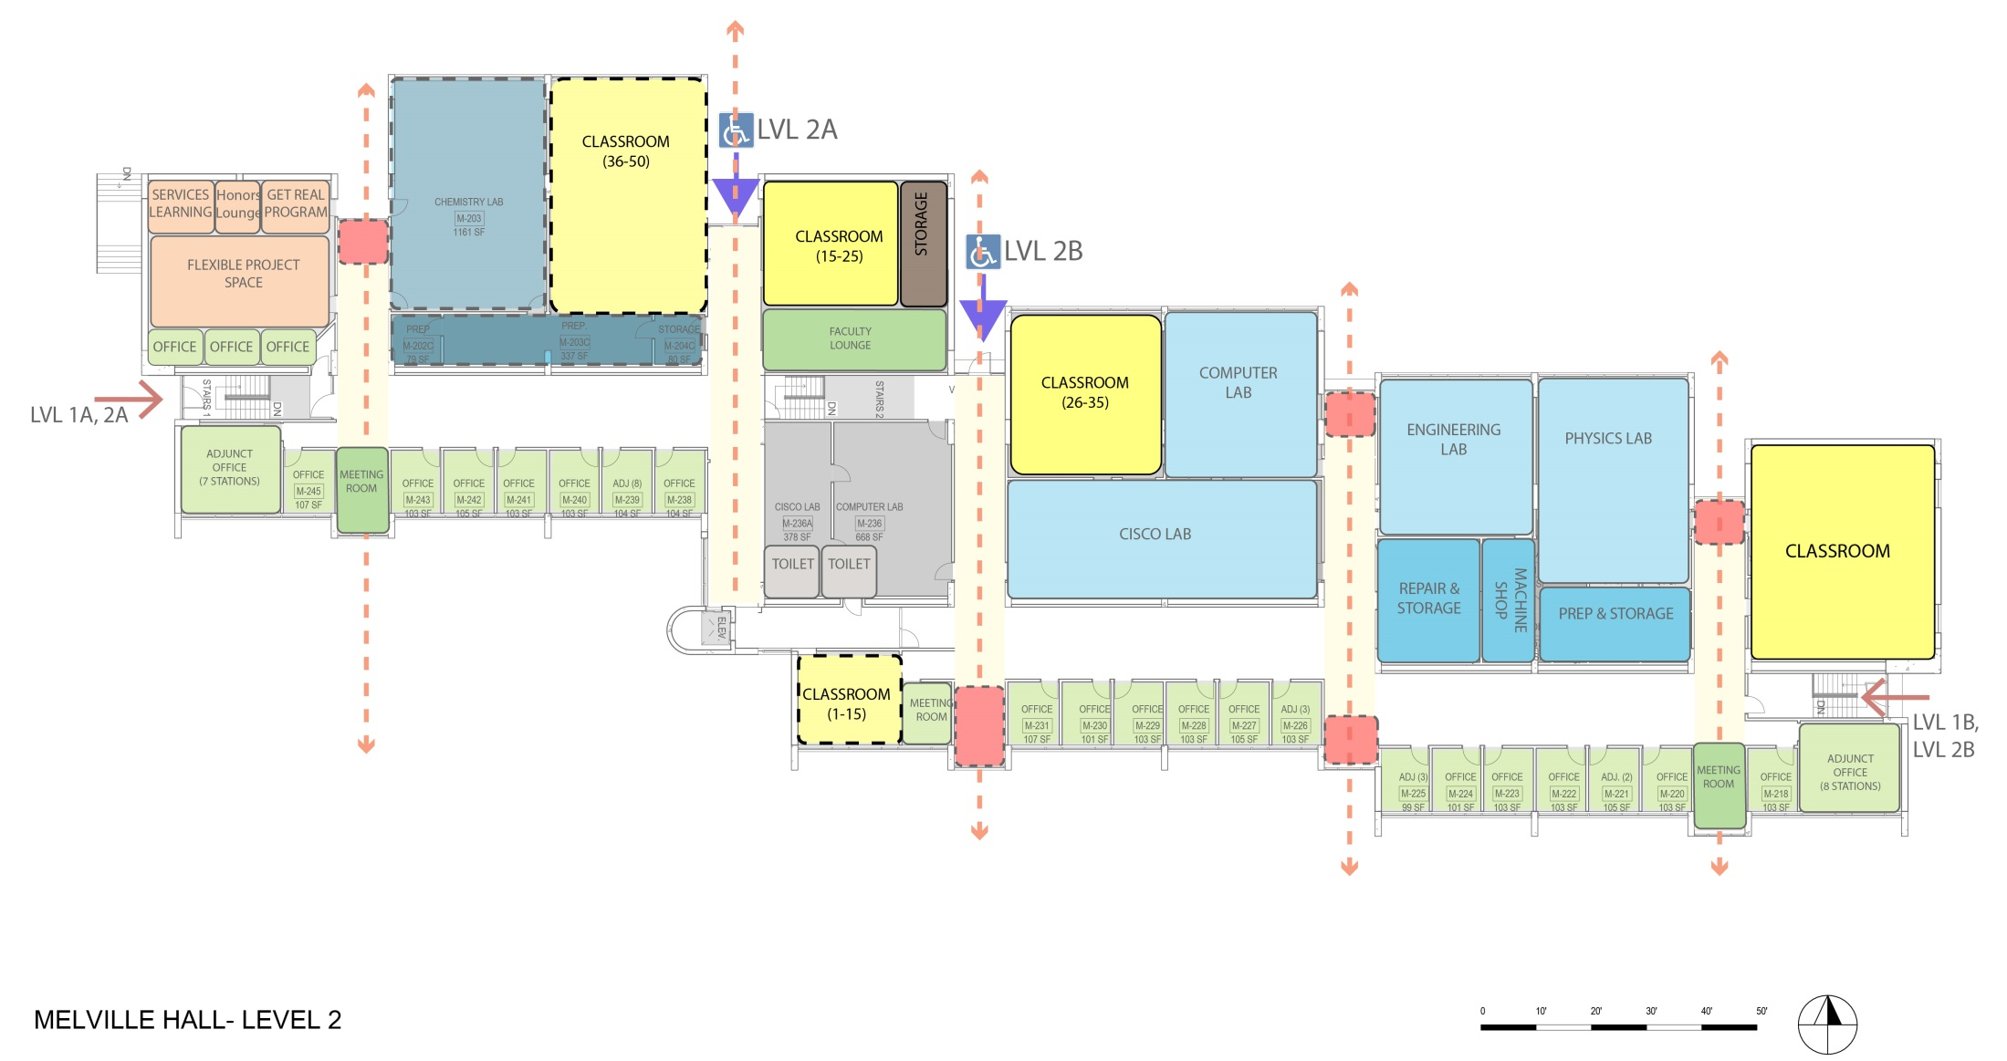
Option 1
MELVILLE Level 2 Classrooms
1-15 1
16-25 1
26-35 1
36-50 x
51-100 2
5

Slide 34
Option 1: Classroom Count
Capacity | M1 | H1 | M2 | H2 | Total | Recommended
1-15 |  |  | 1 | 1 | 2 | 2
16-25 | 6 | 5 | 1 |  | 12 | 10
26-35 | 2 | 4 | 1 | 1 | 8 | 10
36-50 |  |  |  |  | 0 | 0
51-100 |  |  | 2 | 1 | 3 | 2
Total |  |  |  |  | 25 | 24

Slide 35
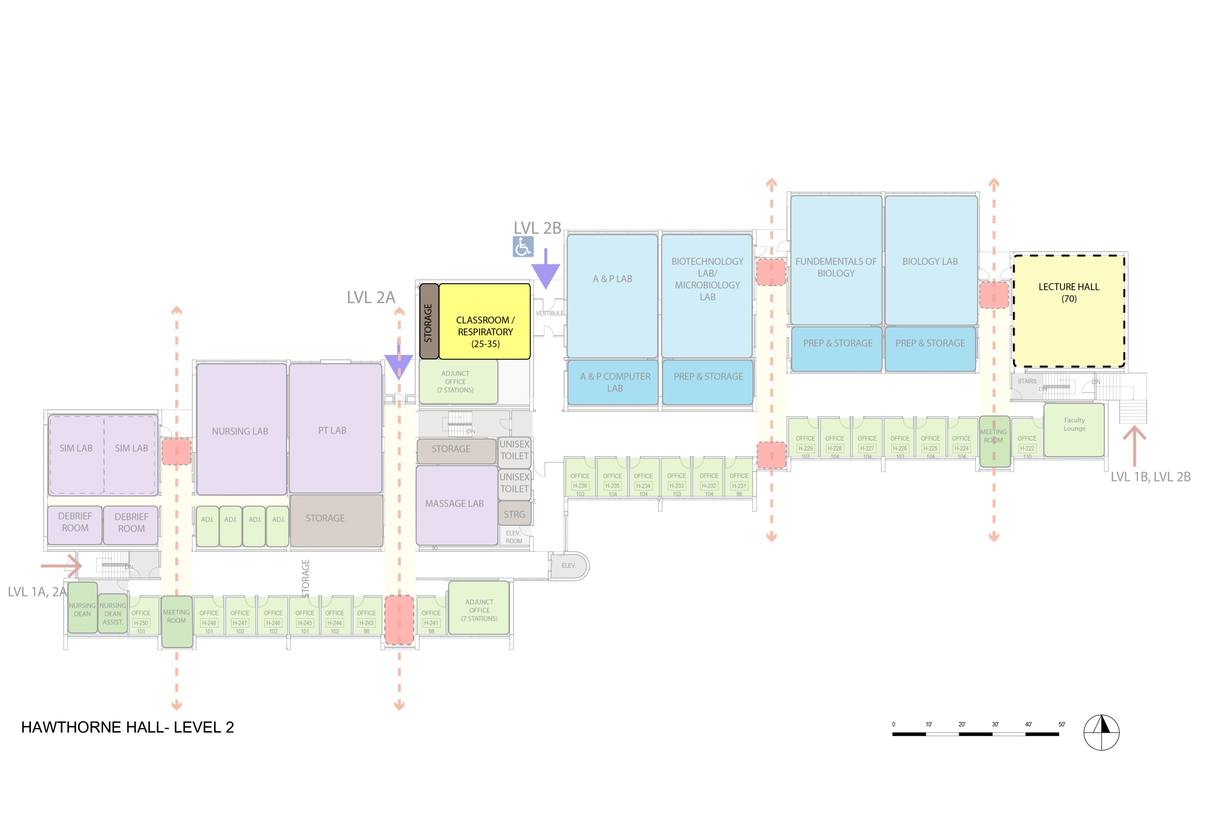
Option 2
Hawthorne Level 2 Classrooms
1-15 x
16-25 x
26-35 1
36-50 x
51-100 1
2

Slide 36
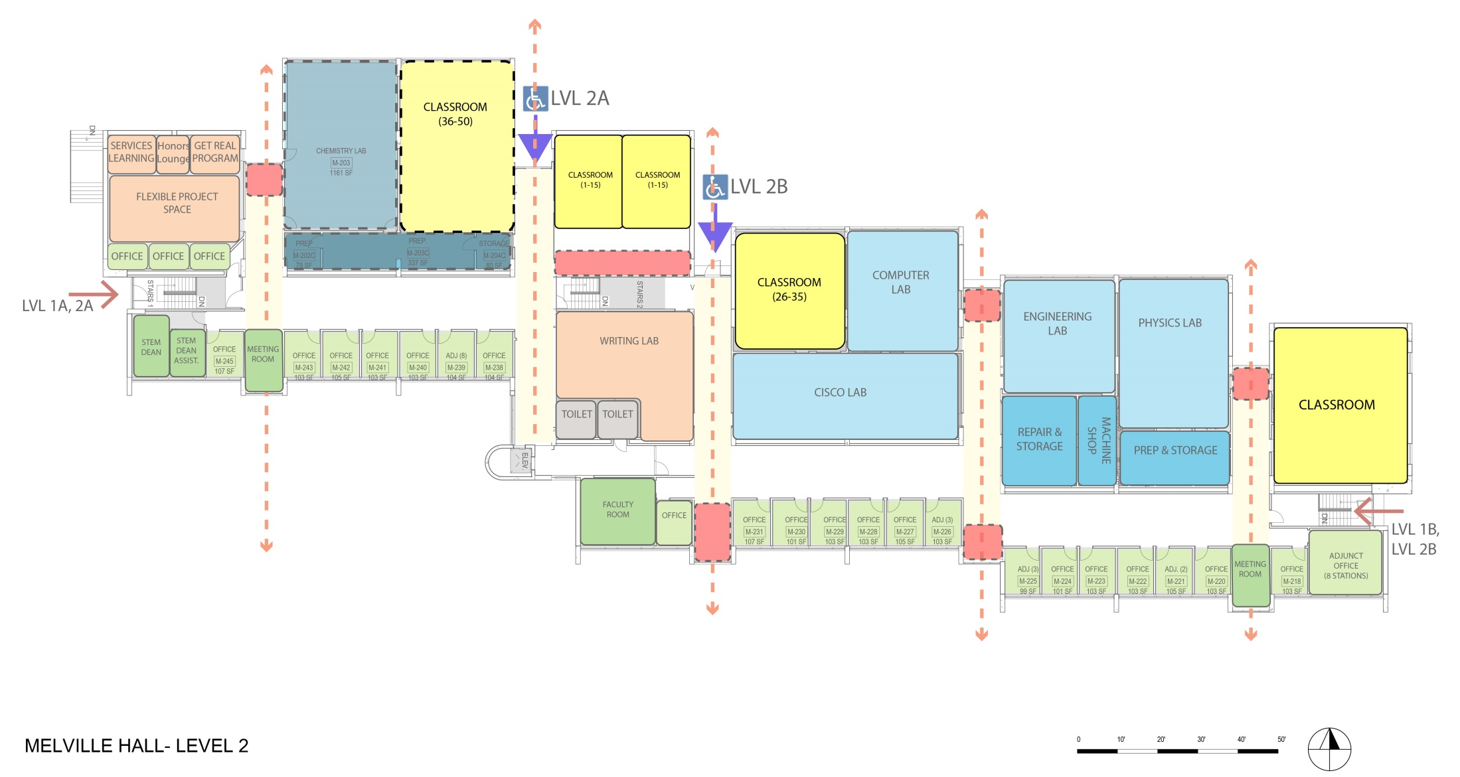
Option 2
MELVILLE Level 2 Classrooms
1-15 2
16-25 x
26-35 1
36-50 x
51-100 2
5

Slide 37
Option 2: Classroom Count
Capacity | M1 | H1 | M2 | H2 | Total | Recommended
1-15 |  |  | 2 |  | 2 | 2
16-25 | 6 | 5 |  |  | 11 | 10
26-35 | 2 | 4 | 1 | 1 | 8 | 10
36-50 |  |  |  |  | 0 | 0
51-100 |  |  | 2 | 1 | 3 | 2
Total |  |  |  |  | 24 | 24

Slide 38
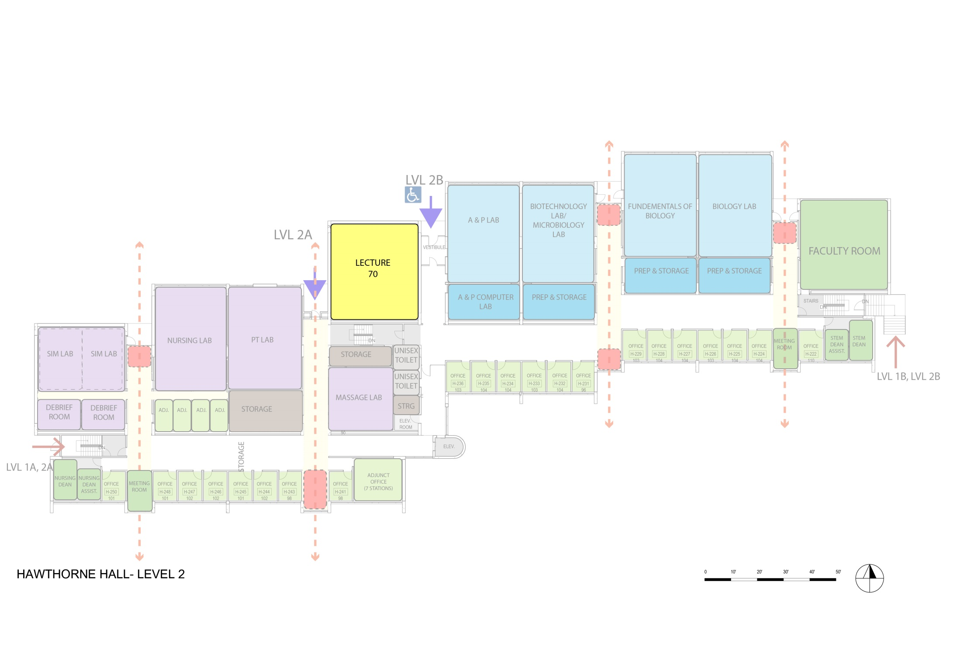
Option 3
Hawthorne Level 2 Classrooms
1-15 x
16-25 x
26-35 x
36-50 x
51-100 1
1

Slide 39
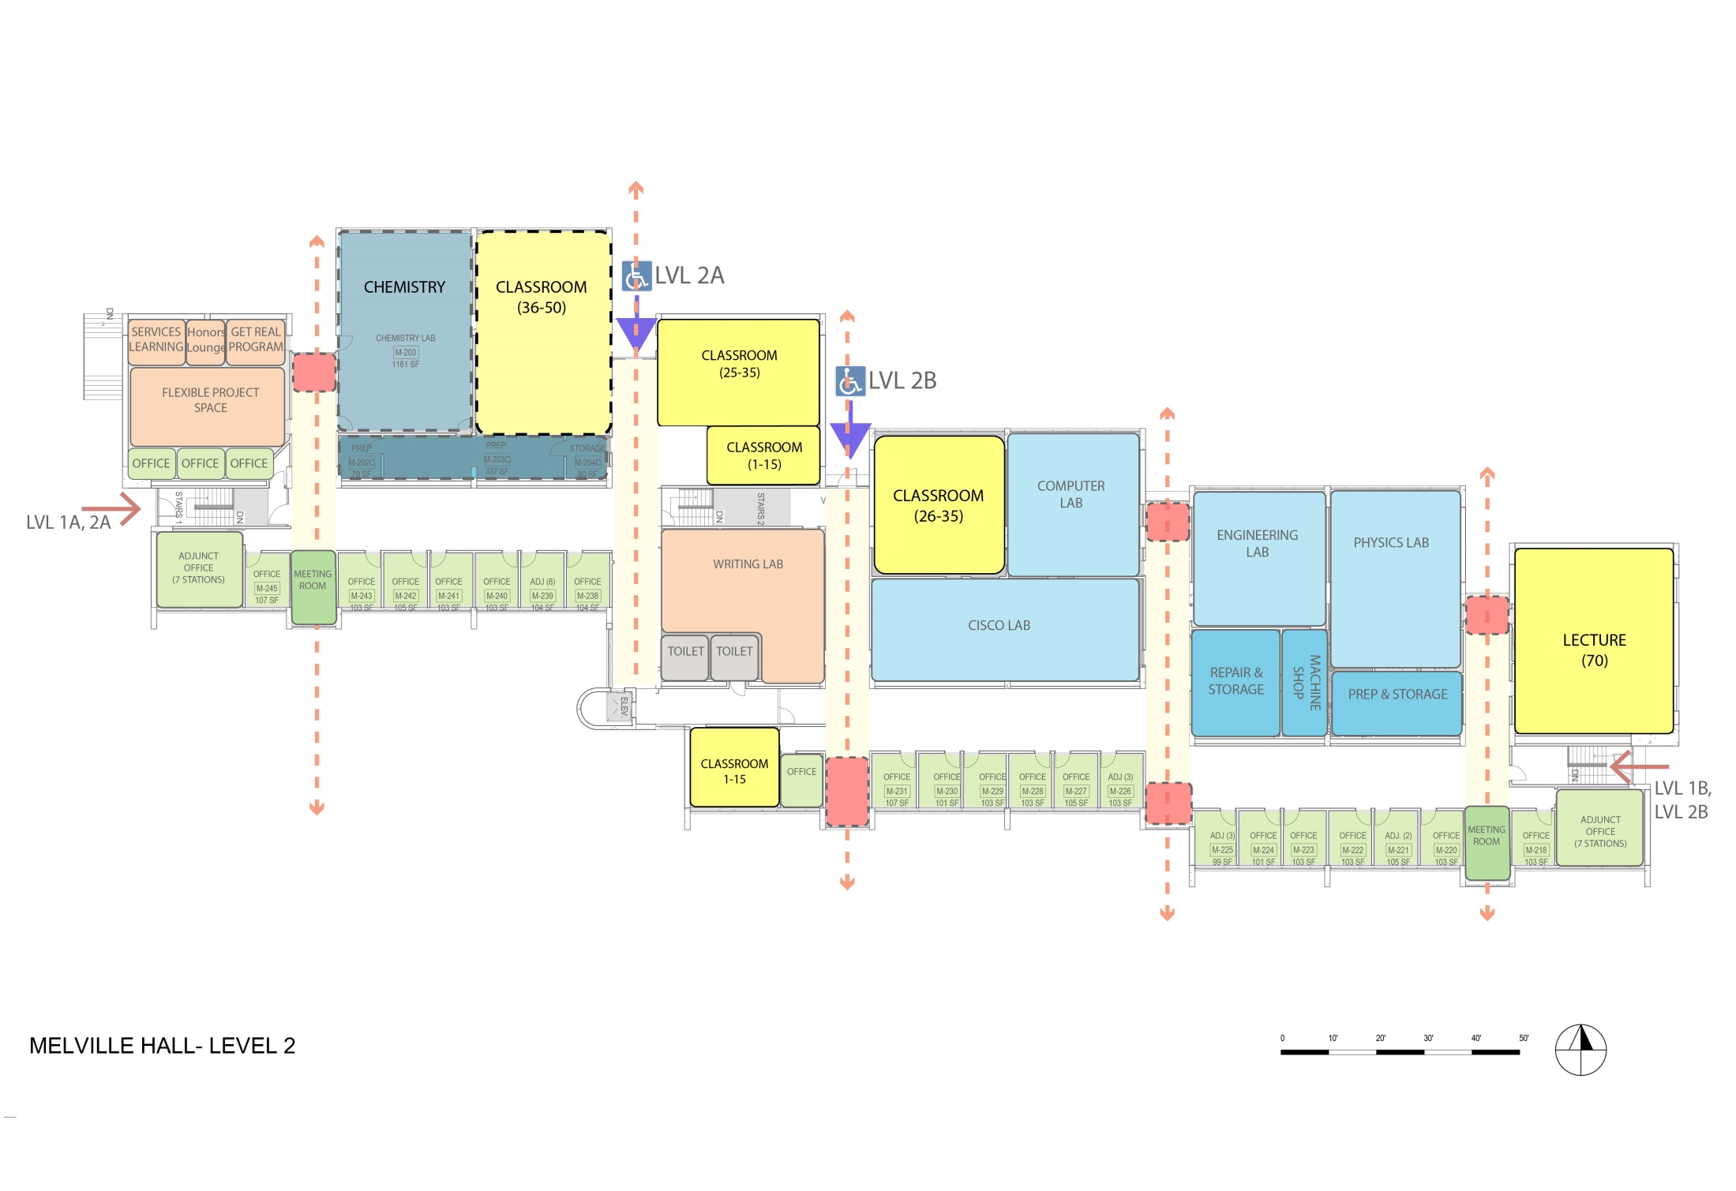
Option 3
MELVILLE Level 2 Classrooms
1-15 2
16-25 x
26-35 2
36-50 x
51-100 2
6

Slide 40
Option 3: Classroom Count
Capacity | M1 | H1 | M2 | H2 | Total | Recommended
1-15 |  |  | 2 |  | 2 | 2
16-25 | 6 | 5 |  |  | 11 | 10
26-35 | 2 | 4 | 2 |  | 8 | 10
36-50 |  |  |  |  | 0 | 0
51-100 |  |  | 2 | 1 | 3 | 2
Total |  |  |  |  | 24 | 24

Slide 41
Option 4
Hawthorne Level 2 Classrooms
1-15 x
16-25 x
26-35 1
36-50 x
51-100 1
2

Slide 42
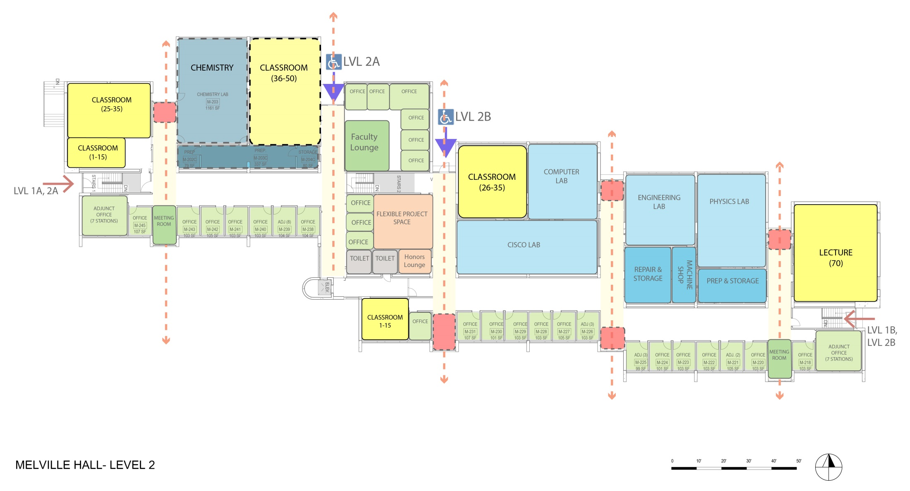
Option 4
MELVILLE Level 2 Classrooms
1-15 2
16-25 x
26-35 2
36-50 x
51-100 2
6

Slide 43
Option 4: Classroom Count
Capacity | M1 | H1 | M2 | H2 | Total | Recommended
1-15 |  |  | 2 |  | 2 | 2
16-25 | 6 | 5 |  |  | 11 | 10
26-35 | 2 | 4 | 2 | 1 | 9 | 10
36-50 |  |  |  |  | 0 | 0
51-100 |  |  | 2 | 1 | 3 | 2
Total |  |  |  |  | 25 | 24

Slide 44
SCIENCES

Slide 45
Science Labs: DCAMM Benchmarks

Slide 46
Science Labs
Room Function | Building | Room Number | # of Stations | Area/ Station | Total Area | # of Stations | Area/ Station | Total Area
Biotech/ Micro Bio | Hawthorne | H-213 | 24 | 42 SF | 1014 SF | 17 | 60 SF | 1014 SF
Biotech Prep & Storage | Hawthorne | H-213C | - | - | 367 SF | - | - | 367 SF
A & P Lab | Hawthorne | H-214 | 24 | 43 SF | 1034 SF | 17 | 60 SF | 1034 SF
A & P Computer Lab | Hawthorne | H-214c | - | - | 374 SF | - | - | 374 SF
Biology Lab | Hawthorne | H-216 | 24 | 45 SF | 1077 SF | 18 | 60 SF | 1077 SF
Biotech Prep & Storage | Hawthorne | H-216C | - | - | 118 SF | - | - | 118 SF
Biology Lab | Hawthorne | H-217 | 24 | 45 SF | 1077 SF | 18 | 60 SF | 1077 SF
Biology Prep & Storage | Hawthorne | H-217C | - | - | 500 SF | - | - | 500 SF
Chemistry Lab | Melville | M-203 | 24 | 48 SF | 1161 SF | 18 | 65 SF | 1161 SF
Chemistry Prep & Storage | Melville | M-202C | - | - | 80 SF | - | - | 80 SF
Chemistry Prep & Storage | Melville | M-203C | - | - | 337 SF | - | - | 337 SF
Chemistry Prep & Storage | Melville | M-204C | - | - | 80 SF | - | - | 80 SF
Electrical Lab | Melville | M-209 | 16 | 52 SF | 825 SF | 16 | 65 SF | 1040 SF
Server Room | Melville | M-209C | - | - | 550 SF | - | - | 0
Electrical Lab Repair and Storage | Melville | M-208A | - | - | 218 SF | - | - | 218 SF
Physics Lab | Melville | M-212 | 24 | 33 SF | 784 SF | 16 | 65 SF | 1040 SF
Physics Storage/ Prep | Melville | M-213C | - | - | 243 SF | - | - | 540 SF
Machine and Repair Shop | Melville | M-253C | - | - | 167 SF | - | - | 167 SF
Physics Storage | Melville | M-257C | - | - | 50 SF | - | - | 0
Small Experiment Lab | Melville | M-259C | - | - | 81 SF | - | - | 0
Optics | Melville | M-260C | - | - | 80 SF | - | - | 0
21 |  |  | 160 |  | 10217 SF | 120 |  | 10224 SF

Slide 47
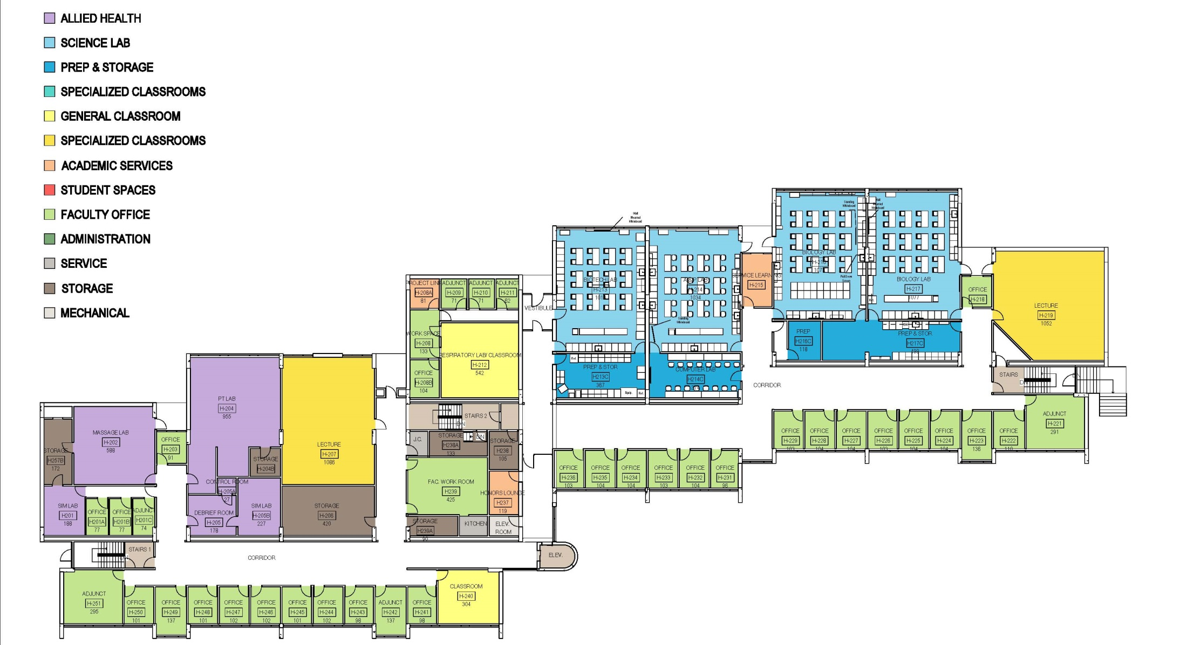
Existing Science Labs in Hawthorne:

Slide 48
Proposed Science Labs in Hawthorne:
Moderate or Major Renovation

Slide 49
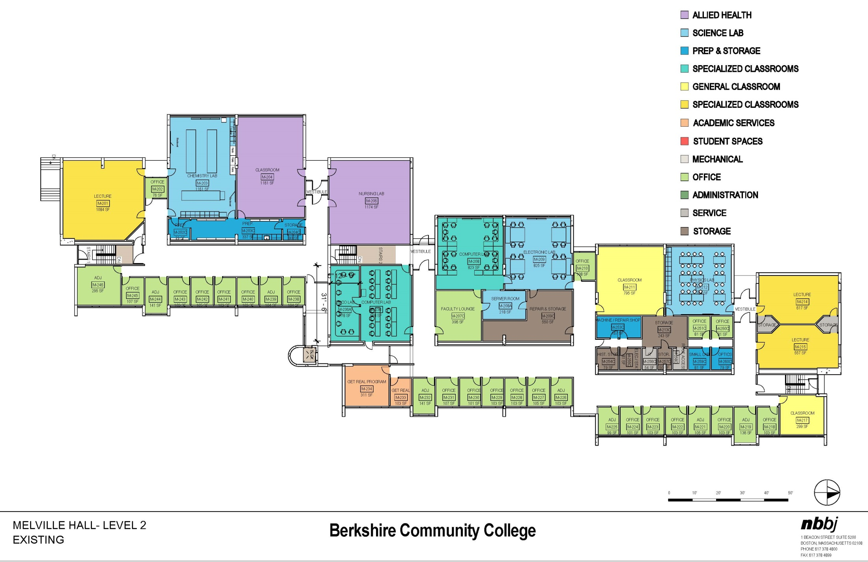
Existing Science Labs in Melville:

Slide 50
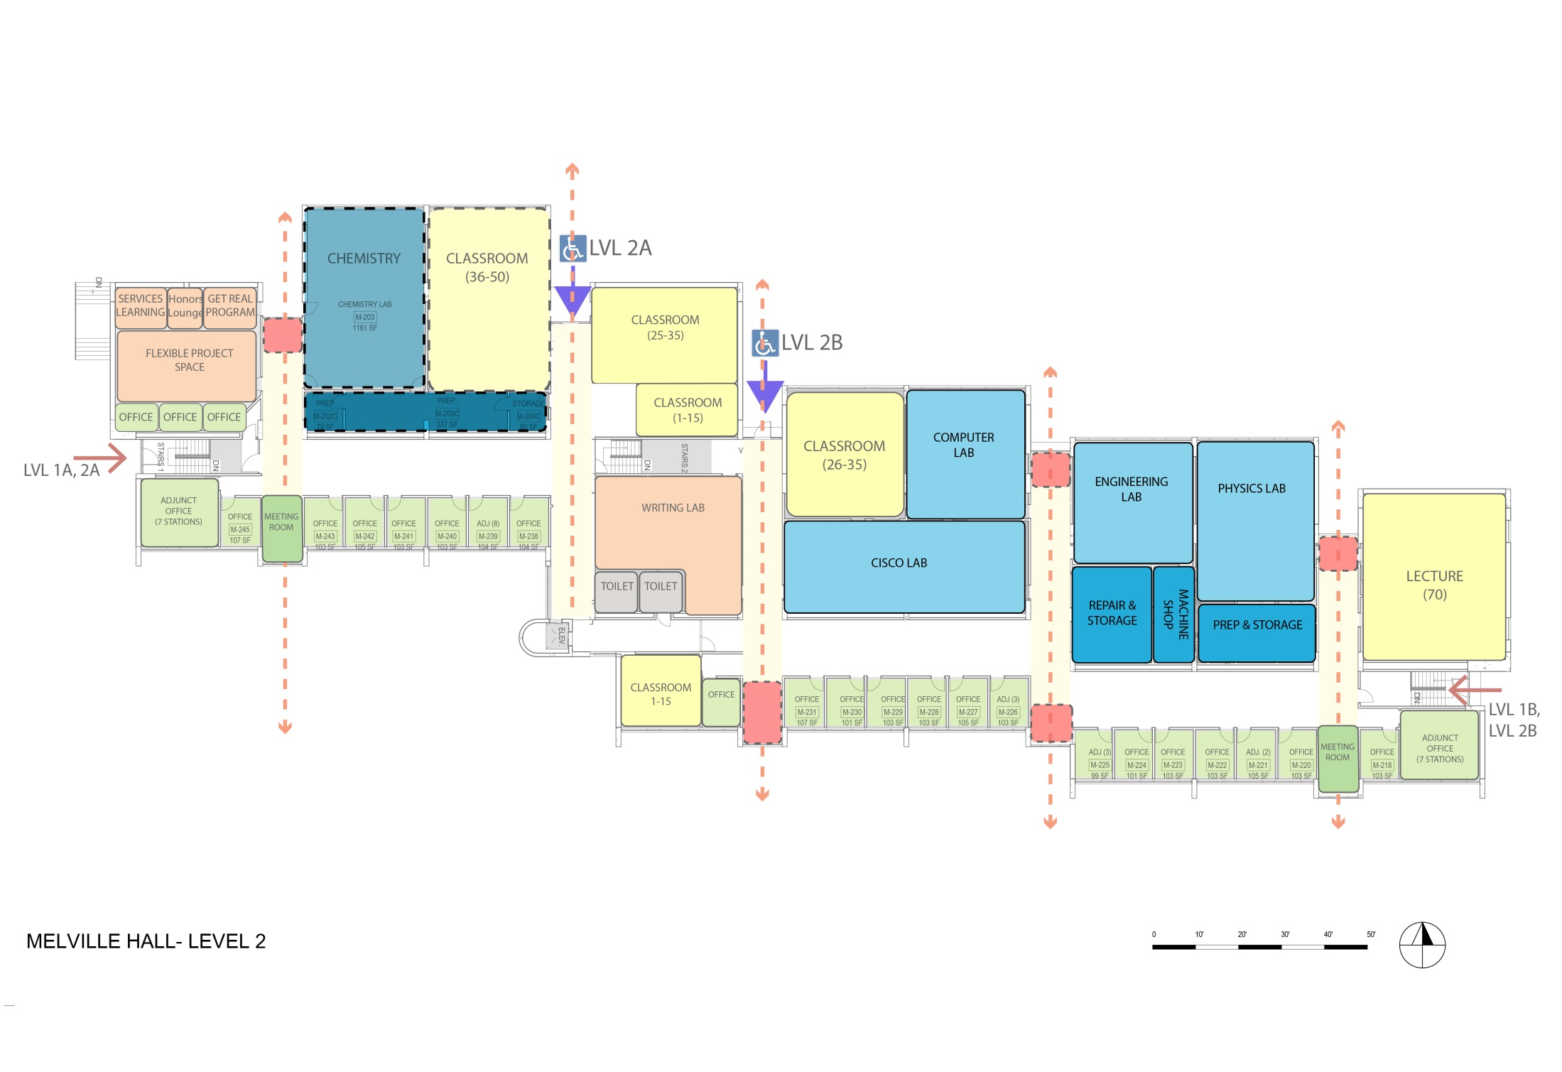
Proposed Science Labs in Melville:

Slide 51
Allied Health

Slide 52
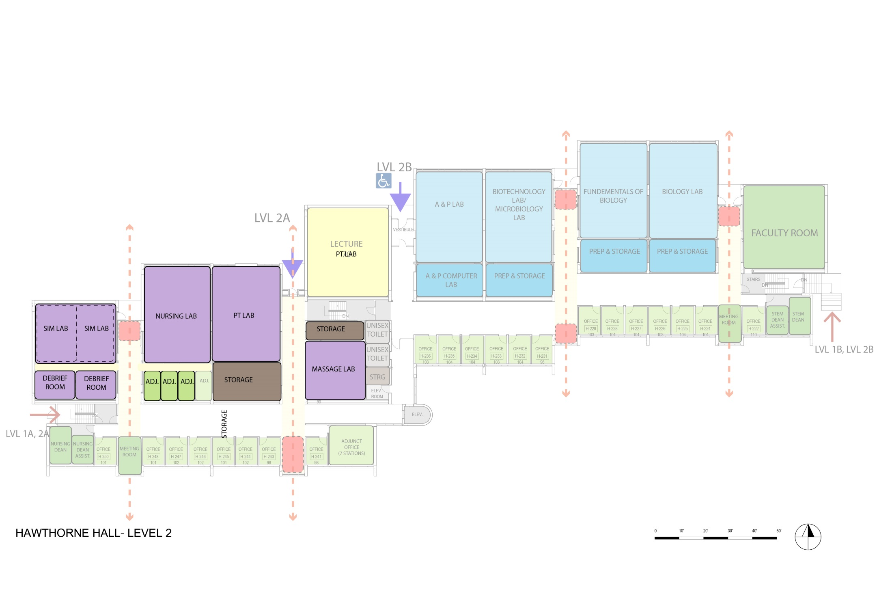
Option 1

Slide 53
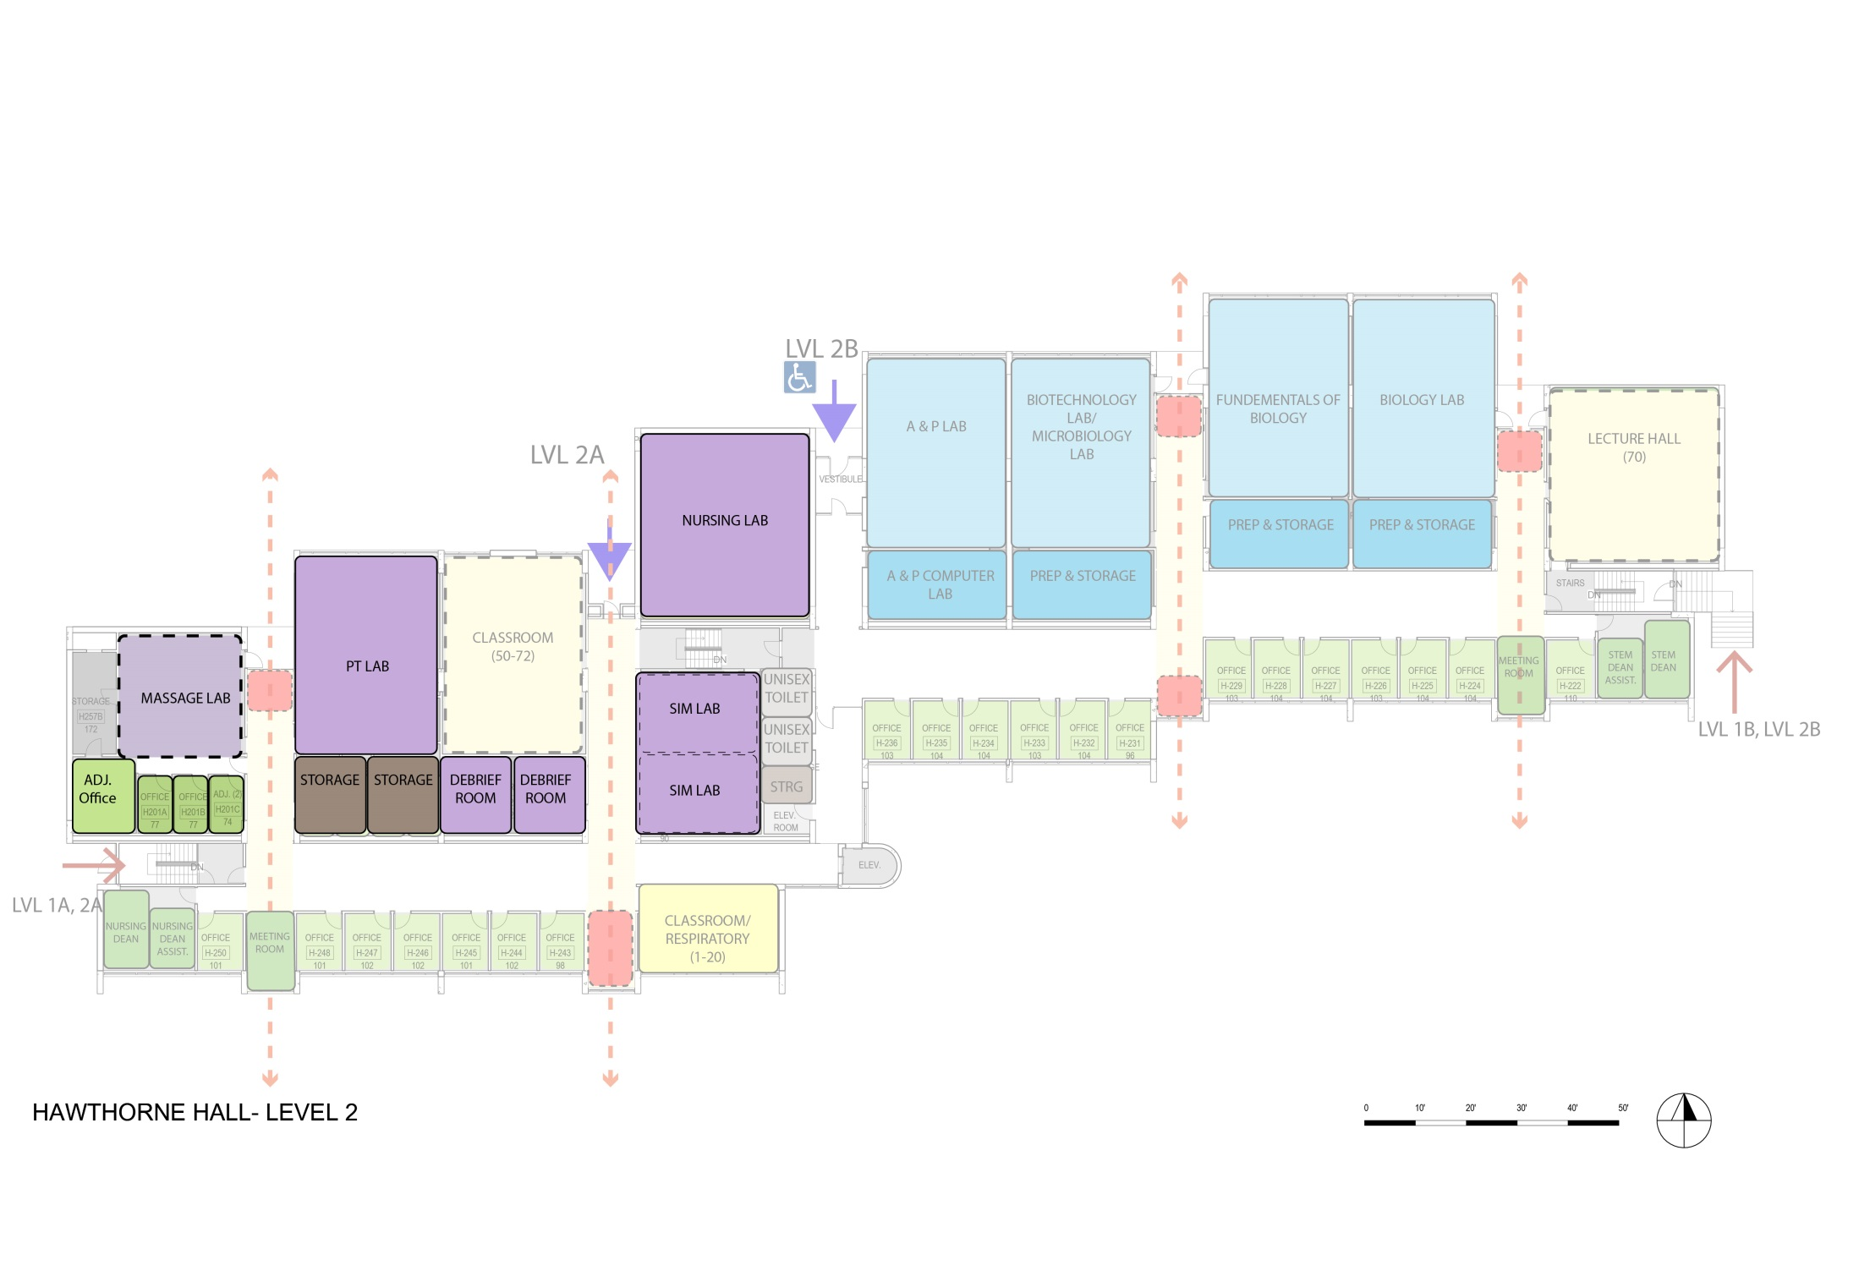
Option 2

Slide 54
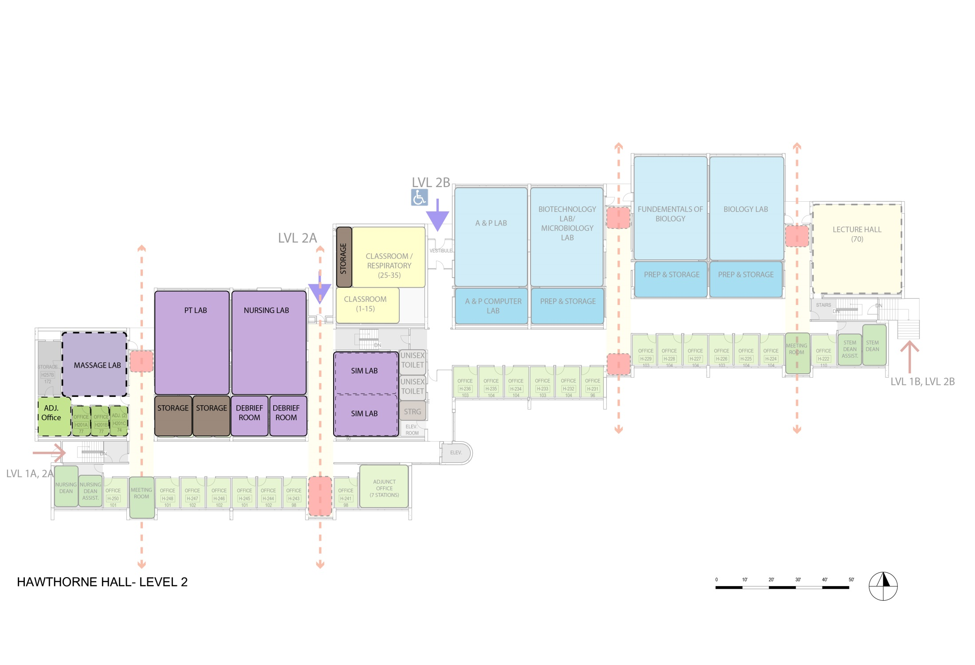
Option 3

Slide 55
STUDENT PROGRAMS

Slide 56
STUDENT PROGRAMS
Service Learning
Project Link
Get Real
Honors
Others ?
Olli
Trio

Slide 57
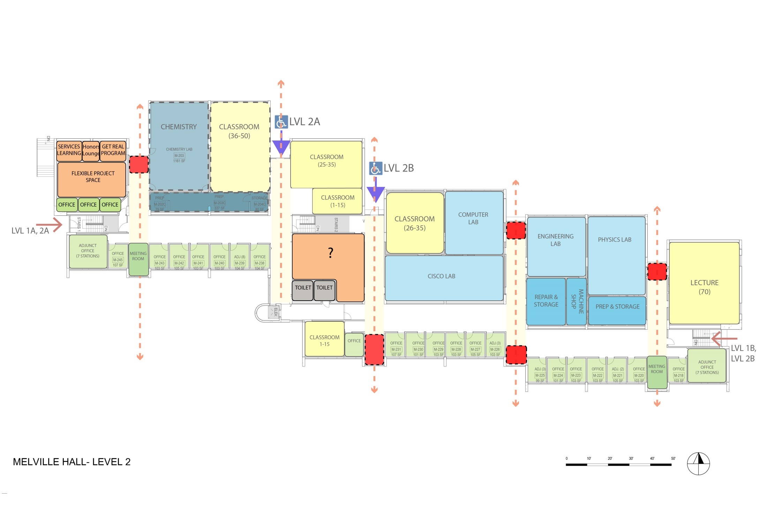
STUDENT PROGRAMS

Slide 58
Connection

Slide 59
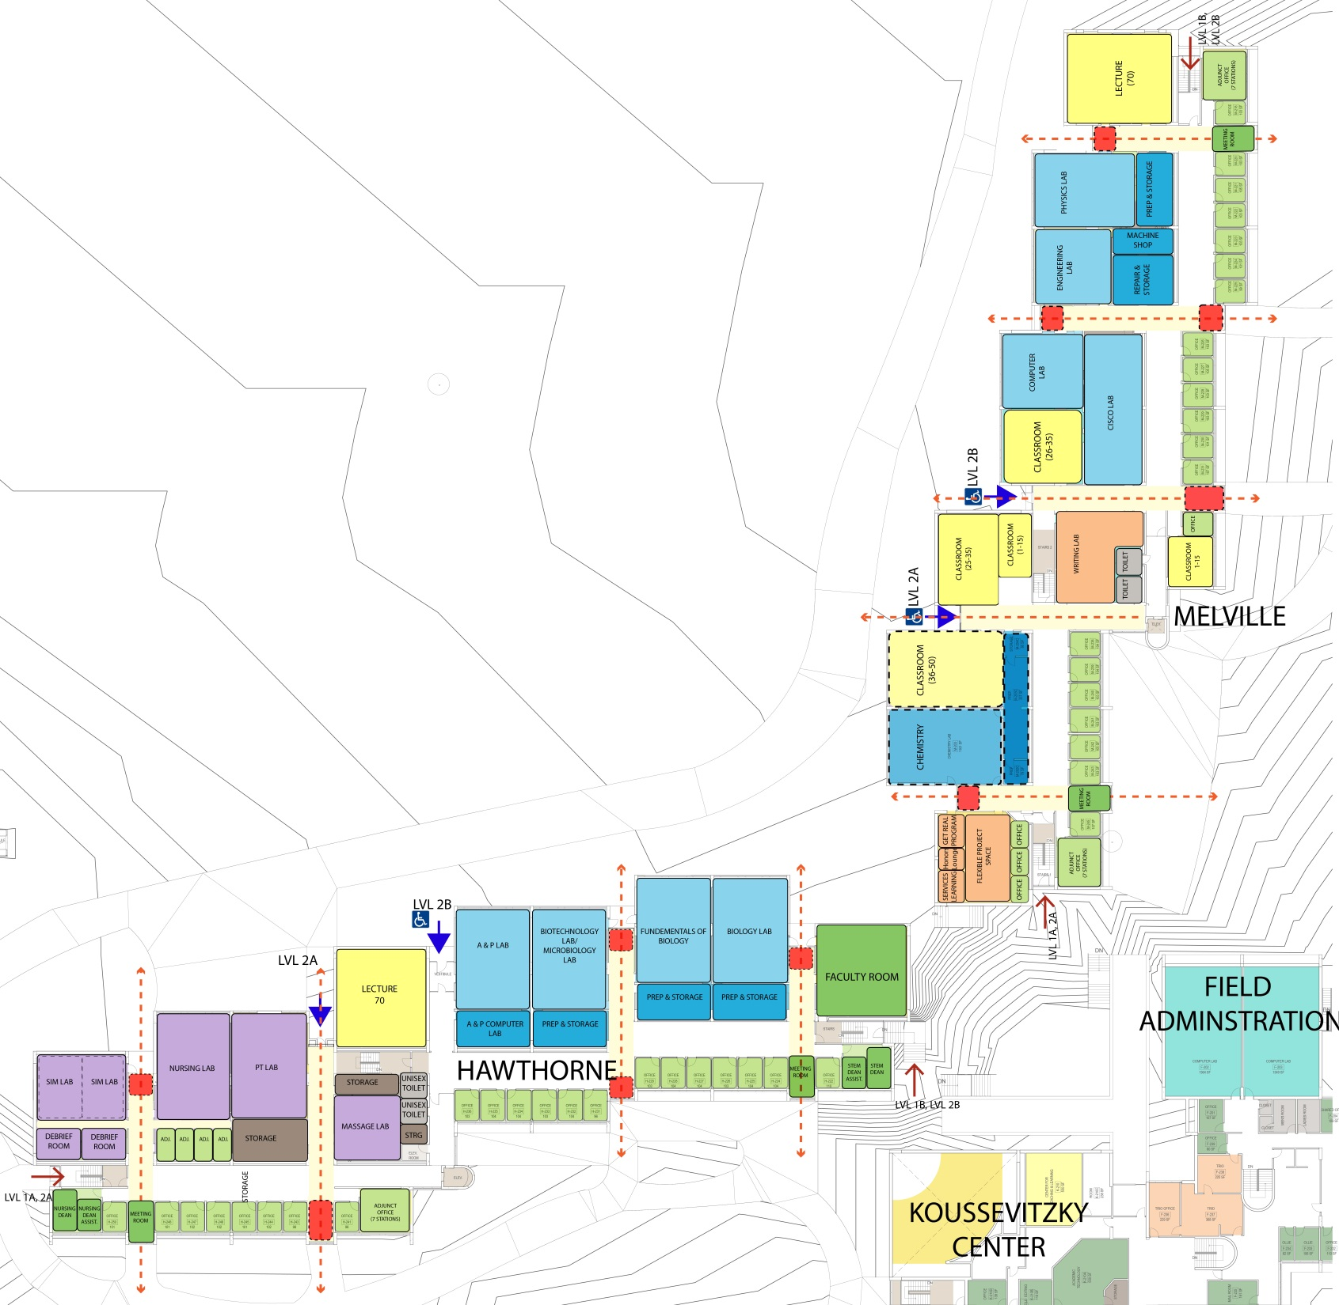

Slide 60
Options

Slide 61
Option 1
STUDENTS
Academic
Services
Faculty

Slide 62
Option 2

Slide 63
Option 3

Slide 64
Landscape

Slide 65
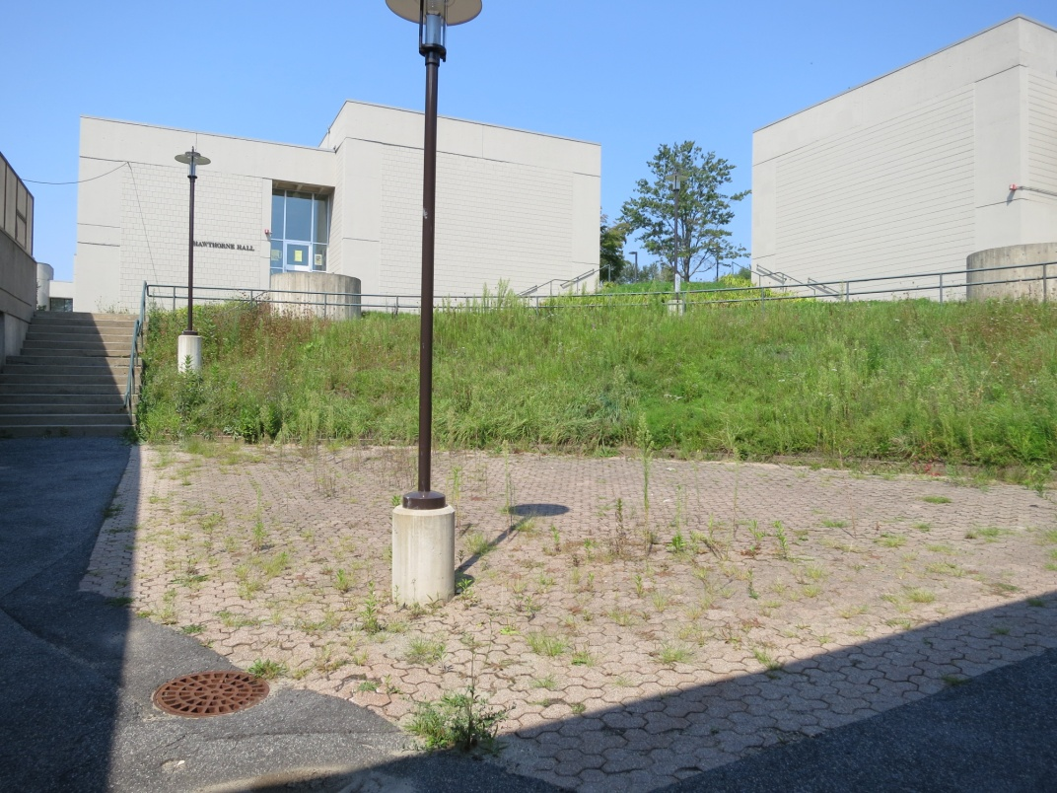

Slide 66
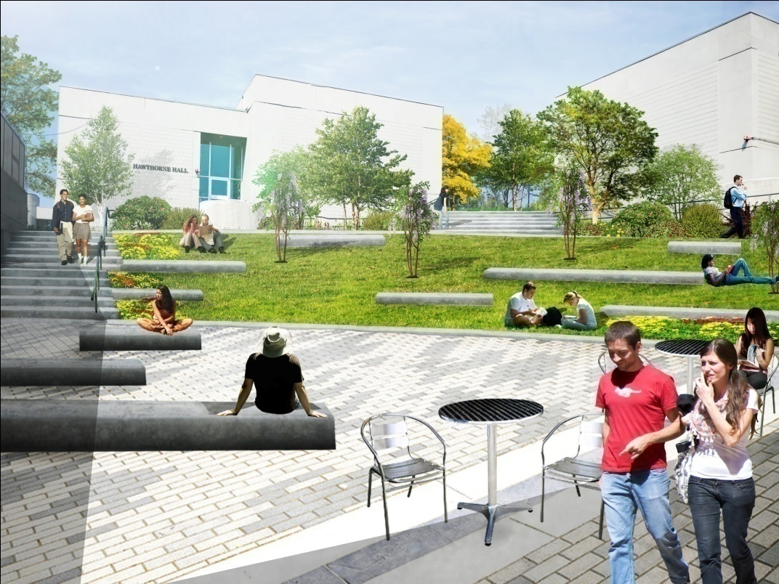

Slide 67
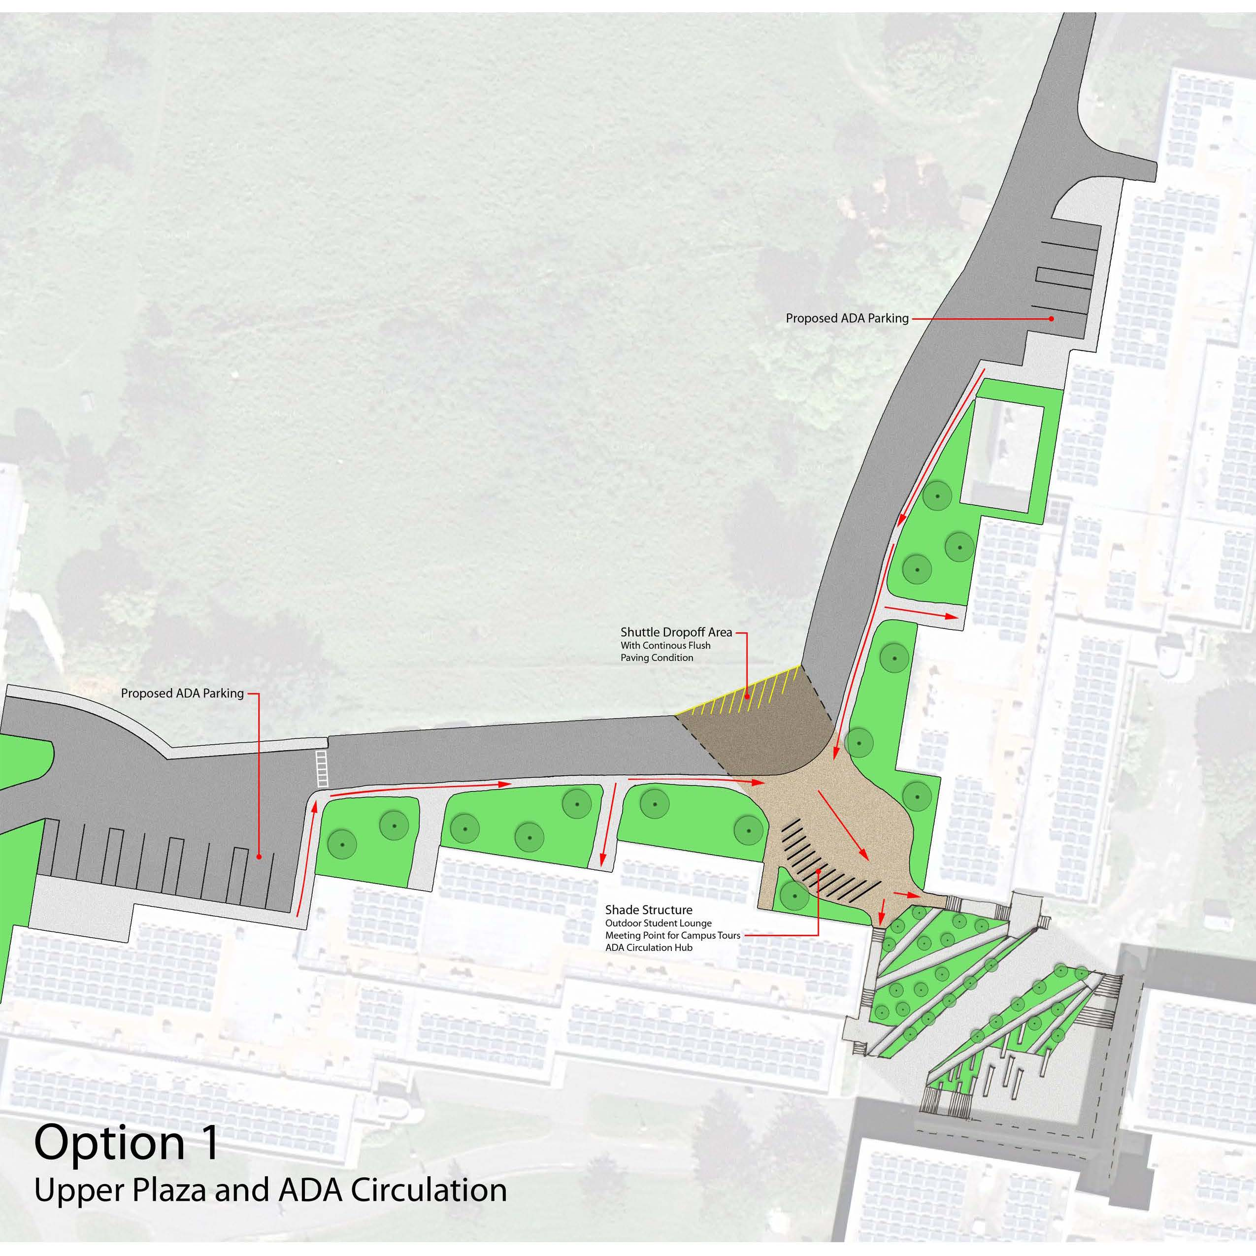
Landscape Options

Slide 68
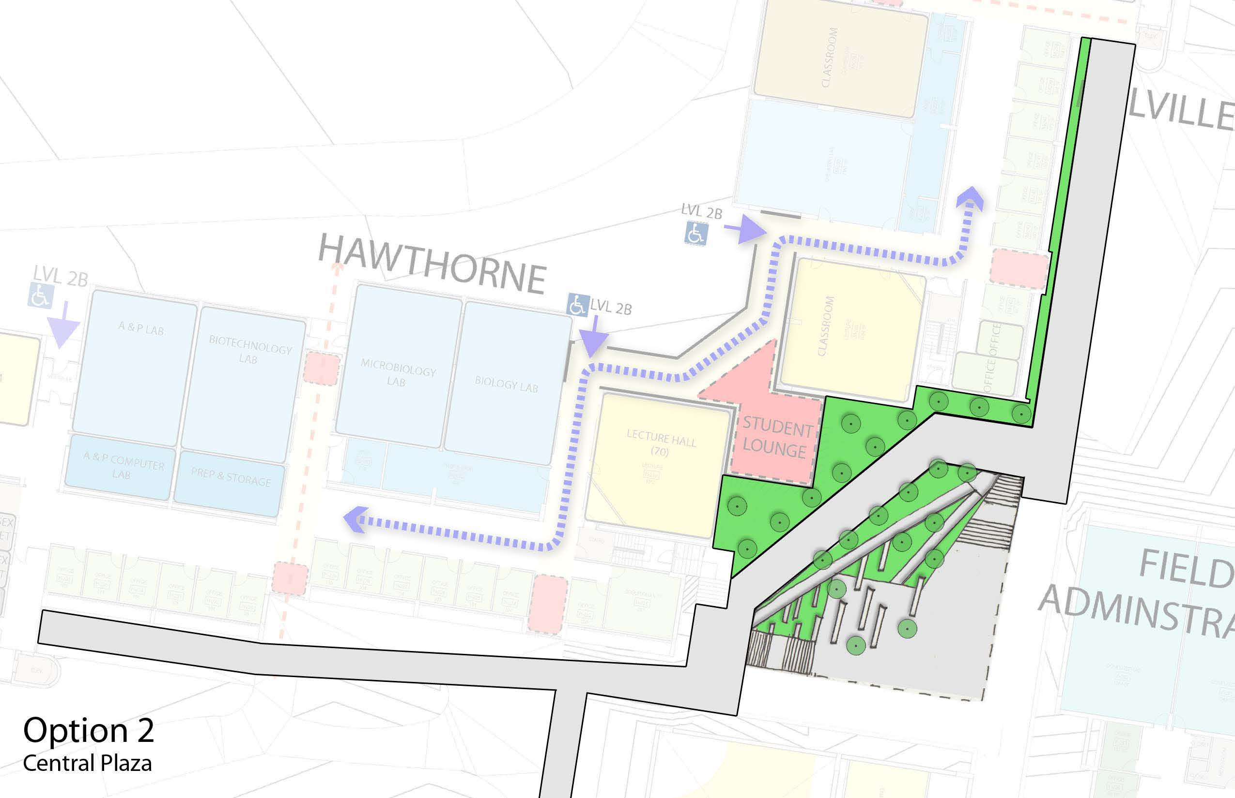
Landscape Options

